Slide 1
Recognizing & Responding to Children at risk
Suspected Child Abuse & Neglect Education for Hospital Staff and Primary Care Providers
Stanley Blondek, DPM, MD, FAAP
A program of the PA Chapter, American Academy of Pediatrics

Slide 2
Learning Objectives
Identify the role of child protection
Describe role of mandated reporter
Define categories of child abuse in the law
Recognize potential risk/indicators of child abuse/neglect
Explain referral process & follow up
Identify prevention resources
©2016 American Academy of Pediatrics

Slide 3
Facts at a Glance
4 million abuse & neglect referrals on 7.2 million children
683,000 child victims
77%- neglect (includes medical neglect)
1,670 deaths- average of 5 per day
75% of fatalities under age 3
National Center for Injury Prevention and Control, 2015 Child Maltreatment Report

Slide 4
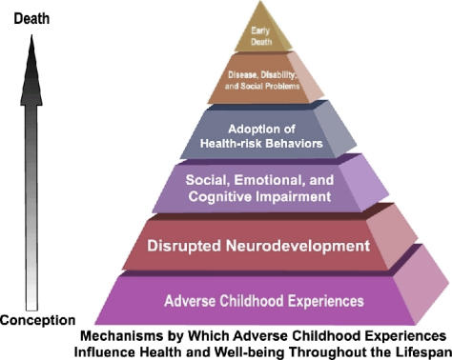
Why it matters, The ACE Study
Adverse Childhood Experiences (ACEs) and the next generation
https://www.cdc.gov/violenceprevention/acestudy/

Slide 5
Identified ACEs
Recurrent physical abuse
Recurrent emotional abuse
Contact sexual abuse
Alcohol/drug abuser in household
Incarcerated household member
Chronically depressed, mentally ill, suicidal
Domestic violence
One or no parents
Emotional or physical neglect
©2016 American Academy of Pediatrics

Slide 6
Two-tiered System
Child Protective Services (CPS) General Protective Services (GPS)
Assessment of safety
Interview/see child
Visit home
Determine need for services
©2016 American Academy of Pediatrics

Slide 7
PA Child Protective Services Law (CPSL)
ChildLine
Children and Youth
Mandated Reporting
©2016 American Academy of Pediatrics

Slide 8
Mandated Reporter
16 categories of mandated reporters
Required to make a report
Based on reasonable cause to suspect
Child does not need to “come before” the mandated reporter
©2016 American Academy of Pediatrics

Slide 9
Mandated Reporter
Must report directly and immediately
Must notify the person in charge or designee
If working as a team, decide who will make the report
Establish a protocol!
©2016 American Academy of Pediatrics

Slide 10
When Required to Report?
Mandated reporters are required to report suspected abuse (choose one)
Only when “on the job”- paid or volunteer
When sure the abuse has occurred
24/7 under certain circumstances
©2016 American Academy of Pediatrics

Slide 11
Answer: C
Mandated reporters are required to report suspected abuse 24/7, regardless if they are “on the job” under the following circumstances:
Person makes disclosure that identifiable child is victim of child abuse
Individual 14 or older discloses he or she has committed child abuse
©2016 American Academy of Pediatrics

Slide 12
Threshold to Report
Suspect:
to surmise to be true or probable
©2016 American Academy of Pediatrics

Slide 13
Confidentiality
Identity of mandated reporter and those who cooperated with investigation can not be disclosed
If law enforcement is involved, person(s) to be to be treated as confidential informant
©2016 American Academy of Pediatrics

Slide 14
Perpetrator of Child Abuse
Parent of child
Spouse/paramour or former spouse/paramour of child’s parent
Person 14 years of age or older and responsible for the child’s welfare or having direct contact with children as an employee of child-care services, a school or through a program, activity or service
Household member 14 years or older
Non-household member over 18 related to child within 3rd degree of consanguinity or by adoption
Person 18 or older who engages a child in severe form of trafficking
©2016 American Academy of Pediatrics

Slide 15
Key point
Mandated reporters must report suspected abuse, regardless of whether the perpetrator is known or unknown

Slide 16
Bodily Injury
Causing bodily injury to a child through any recent act or failure to act that causes impairment of physical condition or substantial pain.
©2016 American Academy of Pediatrics

Slide 17
Caregiver-Fabricated Illness
“fabricating, feigning or intentionally exaggerating or inducing a medical symptom or disease…”
©2016 American Academy of Pediatrics

Slide 18
Serious Mental Injury
Causing or substantially contributing to serious mental injury through act(s) or failure(s) to act.
©2016 American Academy of Pediatrics

Slide 19
Sexual abuse

Slide 20
Sexual Abuse or Exploitation
The employment, use, persuasion, inducement, enticement or coercion of a child to engage in or assist another person to engage in sexually explicitly conduct including but not limited to:
Look at the sexual or other intimate parts of a child or another individual for the purpose of arousing or gratifying sexual desire in an individual
Participating in sexually explicit conversation in-person or by electronic means for the purpose of sexual stimulation or gratification of any individual
Actual or simulated sexual activity or nudity for the purpose or sexual stimulation or gratification of any individual
Actual or stimulate sexual activity or the purpose of producing visual depiction (Including photographing, videotaping, computer depicting or filming) of sexually explicit conduct
©2016 American Academy of Pediatrics

Slide 21
Sexual Abuse or Exploitation
Any of the following offenses against a child:
Rape
Statutory sexual assault
Involuntary deviate sexual intercourse
Sexual assault
Institutional sexual assault
Aggravated incident assault
Indecent assault
Indecent exposure
Incest
Prostitution
Sexual abuse
Unlawful contact with a minor
Sexual exploitation
©2016 American Academy of Pediatrics

Slide 22
Exclusion
Consensual activities between a child who is 14 years of age or older and another person who is 14 years of age or older and whose age is within four years of the child’s age.
©2016 American Academy of Pediatrics

Slide 23
Background
The medical evaluation in suspected sexual abuse is important clinically and forensically.
In the overwhelming majority of cases, even when sexual contact can be proven, the physical examination will be normal.
It is imperative that when findings are present, clinicians are able to recognize them and appropriately interpret their significance.
©2016 American Academy of Pediatrics

Slide 24
Findings Diagnostic of Trauma or Sexual Contact
Acute injury to the external genital or anal tissue
Healed traumatic injuries to the external anogenital region
Acute or healed injury to the internal genital/anal tissues
Sexually transmitted infections (STIs)
Pregnancy
Presence of semen
(Adams 2015)
©2016 American Academy of Pediatrics

Slide 25
Sexual Abuse Findings
Labial Bruising
Note the bruising and petechiae on the bilateral labia majora and the brown bruise on the right labia minora.
This finding can be the result of impact trauma, crush injury (eg, bite), or suction trauma.
This child described the perpetrator placing his face on her genitals.
Labial Lacerations
Laceration at the base of the left labia minora
Laceration between the labia minora and labia majora on the left (pictured).
This could be from direct trauma to the tissues or from traction on the tissues, separating them from one another.
©2016 American Academy of Pediatrics

Slide 26
Sexual Abuse Findings
Penile Bruising
Although anogenital bruising may be the result of sexual abuse from suction, biting, or excessive traction, it may not always indicate a sexual motive.
Toileting accidents are often triggers for abusive genital injury, as seen in the following images.
Perianal Lacerations
©2016 American Academy of Pediatrics

Slide 27
Sexual Abuse Medical Exam
“It’s normal to be normal.”
95% of prepubertal girls and 99% of bots alleging genital contact who are examined non-acutely will have normal examinations following the sexual assault.
Berenson, Am J Obstet Gynecol. April 2000, Heger, et al. Child Abuse Negl. June 2022
©2016 American Academy of Pediatrics

Slide 28
Must report, even if no injury, recent acts that endanger a child
Kicking, biting, throwing, burning, stabbing or cutting
Unreasonable restraining or confining a child
Forcefully shaking a child under the age of one
Forcefully slapping or striking a child under the age of one
Interfering with the breathing of a child
Causing a child to be present where methamphetamine is being manufactured and law enforcement have begun an investigation
Leaving a child unsupervised with an individual (outside of the child’s parent) who is a registered sex offender
©2016 American Academy of Pediatrics

Slide 29
Serious Physical Neglect
Repeated, prolonged, or egregious failure to supervise a child in a manner that is appropriate given the child’s age, development and abilities (can be one-time event)
Failure to provide a child with adequate essentials of life, including food, clothing, shelter or medical care
©2016 American Academy of Pediatrics

Slide 30
Human Trafficking
Recruitment, harboring, transportation, provision or obtaining of a child for labor or services through the use of force, fraud, or coercion. Sex trafficking of a child (prostitution, pornography, exotic dancing, etc.) does not require that there be force, fraud or coercion.
©2016 American Academy of Pediatrics

Slide 31
Child Labor Trafficking
Labor obtained by use of threat of serious harm, physical restraint, or abuse of legal process.
Forced to work for little or no pay (frequently in factories or farms)
Domestic servitude (providing services within a household from 10-16 hours per day)
©2016 American Academy of Pediatrics

Slide 32
Child Sex Trafficking
Involves commercial sex act* that is induced by force, fraud, or coercion, or in which the person induced to perform such act has not attained 18 years of age.
*any sex act on account of which anything of value is given to or received by any person
©2016 American Academy of Pediatrics

Slide 33
Youth at risk for trafficking
In foster care and/or welfare system
Identify as LGBTQ; identify as native or aboriginal
Homeless or runaway
Have disabilities
Mental health or substance abuse disorders
History of sexual abuse
Family dysfunction
©2016 American Academy of Pediatrics

Slide 34
Warning Signs of Trafficking
Prior arrest for prostitution or related changes
Frequent or multiple STIs or pregnancies
No ID or knowledge of personal data such as name, age, DOB
Sexually provocative clothing and/or clothing, hair/nails done with no financial means
Tattoo he/she is reluctant to explain
In a controlling or dominating relationship
©2016 American Academy of Pediatrics

Slide 35
Child abuse prevention

Slide 36
Why Prevent Child Maltreatment?
It is common.
2.6% to 3.4% of parents anonymously admit to shaking their child (Yamada 2014; Reijneveld 2004; Theodore 2005).
13.8% of 4,503 children aged 1 month to 17 years experienced some form of child maltreatment in the last year (Finkelhor 2013).
1 in 4 women and 1 in 6 men report contact sexual abuse when they were children (Dube 2005)
©2016 American Academy of Pediatrics

Slide 37
Why Prevent Child Maltreatment?
It’s expensive.
The annual cost of child abuse is $80.2 billion.
Direct cost: $33 billion
Child welfare alone: $29 billion
Mental health: $1 billion
Acute medical treatment: $3 billion
Law enforcement: $34 million
©2016 American Academy of Pediatrics

Slide 38
Why Prevent Child Maltreatment?
It leads to mental and physical health problems.
The ACE Study and toxic stress
Categories of childhood exposure to adversity (including abuse, neglect, and household dysfunction) are associated in a dose-dependent manner to
Increased prescription rates for antidepressant, anxiolytic, antipsychotic, and mood-stabilizing/bipolar medications in adulthood (Anda 2008)
The most common causes of death in the United States, including severe obesity, heart disease, chronic lung disease, and autoimmune disease (Felitti 1998; Dong 2004; Anda 2008; Dube 2009)
©2016 American Academy of Pediatrics

Slide 39
Why Prevent Child Maltreatment?
It leads to mental and physical health problems.
The ACE Study and toxic stress
Categories of childhood exposure to adversity (including abuse, neglect, and household dysfunction) are associated in a dose-dependent manner to
Increased prescription rates for antidepressant, anxiolytic, antipsychotic, and mood-stabilizing/bipolar medications in adulthood (Anda 2008)
The most common causes of death in the United States, including severe obesity, heart disease, chronic lung disease, and autoimmune disease (Felitti 1998; Dong 2004; Anda 2008; Dube 2009)
©2016 American Academy of Pediatrics

Slide 40
Identify Sentinel Injuries
“Minor injuries other than superficial abrasions are uncommon in normal, precruising infants and, when they occur, should raise a concern for abuse.”
“When a bruise is present, it should be considered as potentially sentinel for physical abuse if there is no predisposing disorder or plausible explanation.”
(Sheets 2013)
©2016 American Academy of Pediatrics

Slide 41
Sentinel Injuries
Previous injury reported in the medical history that was suspicious for abuse because the infant could not cruise, or the explanation was implausible.
©2016 American Academy of Pediatrics

Slide 42
Definition of Sentinel Injury
Minor injuries
Bruise
Intraoral injury
Torn labial or sublingual frenum
Radial head subluxation (nursemaid [pulled] elbow)
Minor burns
Fracture in a young infant
In a pre-cruising infant
Visible or detectable to a caregiver
Poorly explained or unexpected
©2016 American Academy of Pediatrics

Slide 43
Sentinel Injuries in Infants Evaluated for Physical Abuse
Case control, retrospective study of infants under one year evaluated for abuse (Sheets et al Pediatrics, April 2013)
200 infants rated definite abuse:
27% had a previous sentinel injury
100 infants rated intermediate concern
8% had a sentinel injury
101 non abused infants- 0%
Sentinel injuries: bruising or oral injuries in non mobile infants
©2016 American Academy of Pediatrics

Slide 44
P for Possible Abuse Bruises
Padded areas
Buttocks
Cheeks
Genitalia
Abdomen
Protected areas
Neck
Earlobes
Upper lip
TEN4 rule
Torso
Ears
Neck
4 years or younger
Patterned
Slap marks
Grab marks
Circumferential or linear
Pre-cruising infant
Not plausible history
Does seriousness of injury match seriousness of story? Example: multiple bruises but only one impact reported.
©2016 American Academy of Pediatrics

Slide 45
TEN-4 FACES high risk areas, any age
Torso- chest, abdomen, back, buttocks
Ears
Neck
FACES- Frenulum, Angle of jaw, Cheek, Eyelid, Sclera
Very concerning in infants under 4 months.
Pierce, MC Pediatrics January 2010
©2016 American Academy of Pediatrics

Slide 46
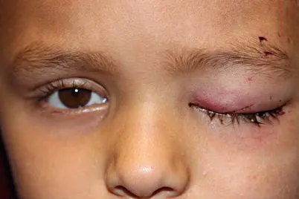
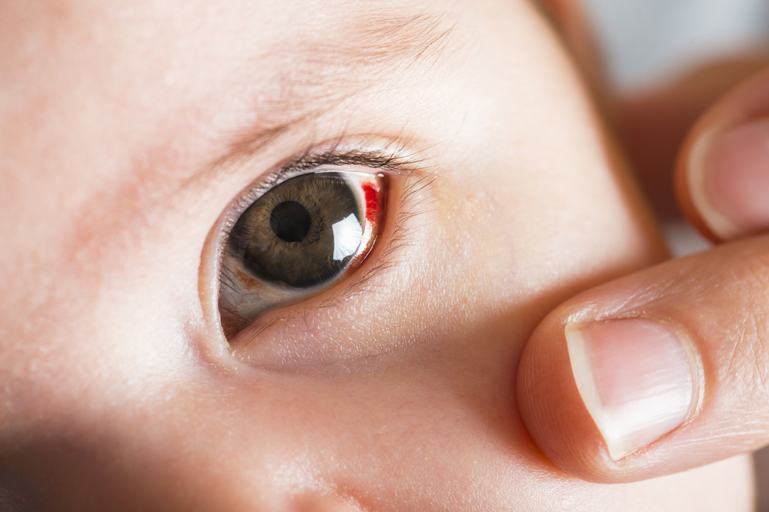
FACES- Frenulum, Angle of jaw, Cheek, Eyelid, Sclera
©2016 American Academy of Pediatrics

Slide 47
Those Who Don’t Cruise…Rarely Bruise
2 of 366 children younger than 6 months (0.6%) had any bruises.
Whereas roughly 20% of cruisers and 50% of walkers had bruises.
Common sites
Anterior tibia, knee.
Forehead.
434 of 466 bruises (93%) were over bony prominences.
Uncommon sites
Back, forearm, face (<2%)
Abdomen (0.9%)
Posterior lower leg or foot (0.3%)
Buttocks, hands, chin (0)
©2016 American Academy of Pediatrics

Slide 48
Suspicious Death
Causing the death of the child through any act or failure to act
©2016 American Academy of Pediatrics

Slide 49
Exclusions from child abuse
Environmental factors
Practice of religious beliefs
Use of force for supervision, control and safety
Rights of parents to use reasonable force
Participation in events involving physical contact
Child-on-child contact
Defensive force
*These exclusions apply to substantiation of child abuse, not to the requirement to report
©2016 American Academy of Pediatrics

Slide 50
Risk factors for child abuse and/or neglect
Child Factors
Prematurity
Chronic medical conditions (i.e. medically fragile child)
Disability
Poor bonding with caregiver
Child perceived as “difficult” (i.e. colicky baby)
Unwanted child
Sibling of an abused child
©2016 American Academy of Pediatrics

Slide 51
Risk factors for child abuse and/or neglect
Caregiver Factors
Abused as a child
Mental illness
Substance abuse
Teenage parent
Unreasonable expectations for the child
Punitive childrearing style
Multiple births
Poor coping skills
©2016 American Academy of Pediatrics

Slide 52
Risk factors for child abuse and/or neglect
Family Factors
Unemployment
Financial stressors
Lack of support/isolation
Nonbiologically-related male in the home
Domestic violence
Animal abuse
©2016 American Academy of Pediatrics

Slide 53
Information to gather
Past medical history
Previous trauma/injuries/chronic illness
Birth trauma and administration of Vitamin K at birth
Developmental history
Current milestones and any delays
Observe child’s abilities while in the room
©2016 American Academy of Pediatrics

Slide 54
Family History
Bleeding disorders, collagen vascular disease, easy bruising, easily fractured bones, poorly healed fractures, dental and hearing abnormalities
Recurrent infant deaths (concerning for SIDS, metabolic disorders, and infanticide)
“Small children” – could signal neglect
©2016 American Academy of Pediatrics

Slide 55
When should abuse be considered?
History inconsistent with injuries
History incompatible with child’s development
History that changes with time
Delay in seeking treatment
Suspicious injuries
©2016 American Academy of Pediatrics

Slide 56
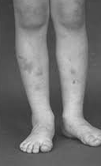
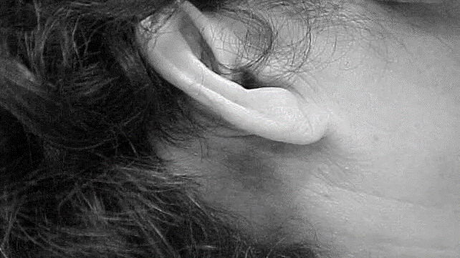
Examination- undress child. Look everywhere
Used by permission from AAP
©2016 American Academy of Pediatrics

Slide 57
Bruising
Definitions and Mechanisms
Bruise (or contusion)
Almost always from blunt force trauma.
Key factors include amount and duration of force, location of injury on body, and contour and rigidity of object involved.

Slide 58
Introduction
Cutaneous injuries are the single most common presentation of child physical abuse.
Lesions include bruises, burns, bite marks, abrasions, and petechiae.
Often, the diagnosis of abuse cannot be made on the basis of the injury appearance in isolation. Taking a comprehensive history is crucial.
Reporting suspicious injuries to child protective services promptly is essential so that a coordinated multidisciplinary investigation/evaluation can take place.
©2016 American Academy of Pediatrics

Slide 59
Typical Locations of Bruises
©2016 American Academy of Pediatrics

Slide 60
Petechiae
Abrasion
Petechiae are red, purple, or brown pinpoint hemorrhages (1–3 mm) in the skin believed to arise from rupture of venous capillaries (also called postcapillary venules).
May be caused by medical conditions, elevated venous pressure (eg, after severe coughing, vomiting, or strangulation) (Bilo 2013), or blunt force trauma.
Bruises associated with petechiae are much more common in inflicted than non-abusive bruises (Nayak 2006; Kemp 2014).
Superficial skin injury.
Trauma to epidermis (removal, detachment).
Usually by blunt force trauma, eg, impact/compression, friction with shearing forces.
©2016 American Academy of Pediatrics

Slide 61
Laceration
Incision/Stab Wound
Full-thickness skin injury.
Tearing of tissue in a frayed and irregular pattern.
Wound edges may be bruised, abraded, or crushed.
Typically caused by blunt force trauma: compression, collision, shearing/stretching; if sharp force trauma, a jagged edge.
Tissue bridges can be seen within the tear.
Injuries with clean edges.
Depth can vary.
Caused by sharp object.
An incision (top image) is longer than deep; caused by a slicing motion, eg, paper, knife, razors.
A stab (bottom image) is deeper than long; caused by, eg, needle, dagger.
©2016 American Academy of Pediatrics

Slide 62
Concern for Abusive Bruising
Bruising in children who are not independently mobile (Maguire 2005; Maguire 2013; Kemp 2014)
Bruising in babies (Maguire 2005; Maguire 2013; Kemp 2014)
Bruises away from bony prominences or on the back of the body (Maguire 2005; Maguire 2013)
Bruises to the face (Maguire 2005; Maguire 2013; Kemp 2014), neck (Maguire 2013; Kemp 2014), trunk (Maguire 2005; Maguire 2013; Kemp 2014), arms (Maguire 2005; Maguire 2013; Kemp 2014), buttocks (Maguire 2005; Maguire 2013; Kemp 2014), ears (Maguire 2005; Maguire 2013; Kemp 2014), and hands (Maguire 2005)
©2016 American Academy of Pediatrics

Slide 63
Concern for Abusive Bruising
Multiple bruises in clusters or of uniform shape or linear (Maguire 2005; Maguire 2013; Kemp 2014)
Bruises that carry the imprint of implement used or a ligature (Maguire 2005; Maguire 2013; Kemp 2014)
Larger bruises (Maguire 2005; Maguire 2013) or bruises associated with petechiae (Maguire 2013; Kemp 2014)
More bruises or bruises over a large number of body regions (Kemp 2014)
©2016 American Academy of Pediatrics

Slide 64
Ears
Neck
Studies of normal children reveal the ear is very rarely bruised (<0.2% of examinations) (Kemp 2014; Kemp 2015).
Ear bruising is strongly associated with abuse in comparative studies. Thus, the bruising of the pinna in this child is quite concerning.
Day-to-day bruises in healthy children are extremely rare on the neck (Kemp 2015).
Skin injury to the neck is strongly associated with abuse (Kemp 2014).
©2016 American Academy of Pediatrics

Slide 65
Trunk
Buttocks
Day-to-day bruises in healthy children do sometimes occur on the trunk, often the lumbar region (Chang 2007) or, if on the front, over bony prominences such as iliac crests (Kemp 2015).
Trunk bruises, however, are associated with abuse (Kemp 2014) and, hence, must be carefully assessed.
Buttocks are rarely bruised in non-abusive injury (especially in the youngest children). Buttocks bruising is strongly associated with abuse in case-control studies.
Blunt force trauma across the buttocks can leave the appearance of linear marks parallel to gluteal cleft when the buttocks are clenched.
©2016 American Academy of Pediatrics

Slide 66
Abdomen
Forearm
Significant bruises on the abdomen such as these are highly suspicious and should prompt evaluation for intra-abdominal injuries and occult injuries such as fractures and intracranial hemorrhage.
Forearm bruises can be non-abusive but can also reflect defensive injuries.
©2016 American Academy of Pediatrics

Slide 67
Bruises
“Those who don’t cruise rarely bruise”
©2016 American Academy of Pediatrics

Slide 68
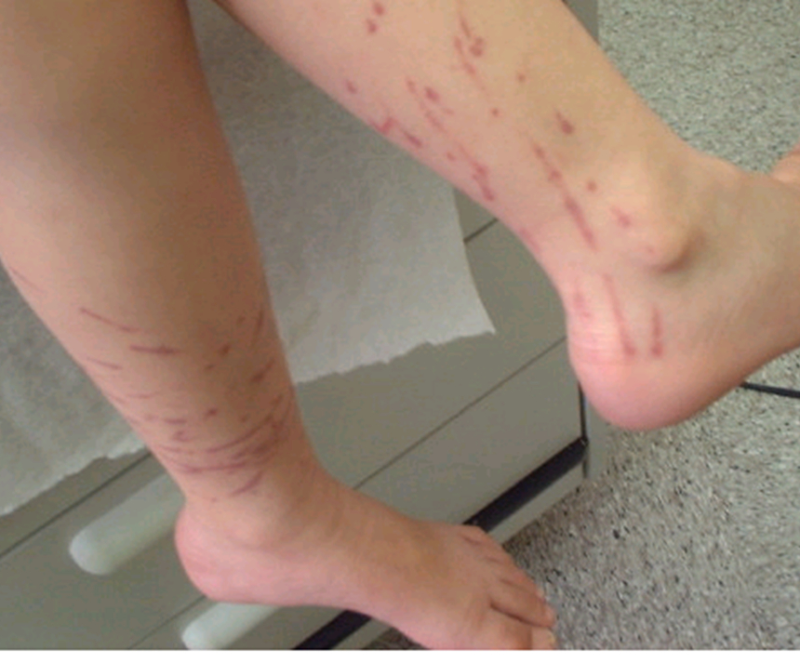
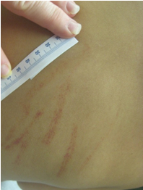
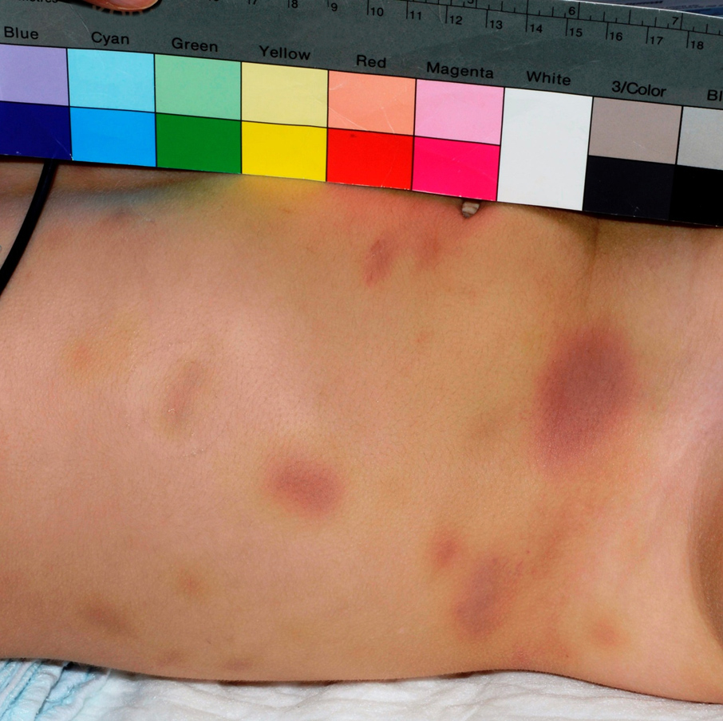
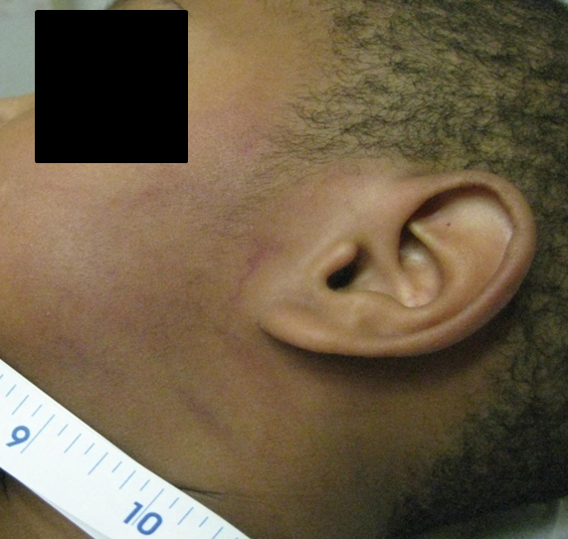
Other Factors
Linear Bruises
Bamboo Switch
Bruises in clusters, or linear bruises, are associated with abuse. Larger bruises are associated with abuse in some (Maguire 2013), but not all (Kemp 2014), studies. Even if the implement was not apparent, notice the clustering of similarly patterned injuries. Injuries that have typical parallel linear marks on the face consistent with a slap and are bilateral further strengthen the identification of child abuse
Clustered Bruises
Slap Marks
©2016 American Academy of Pediatrics

Slide 69
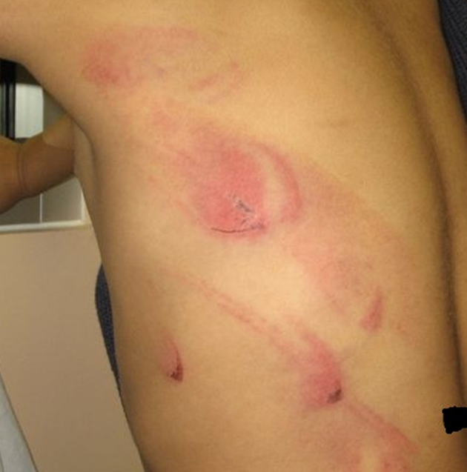
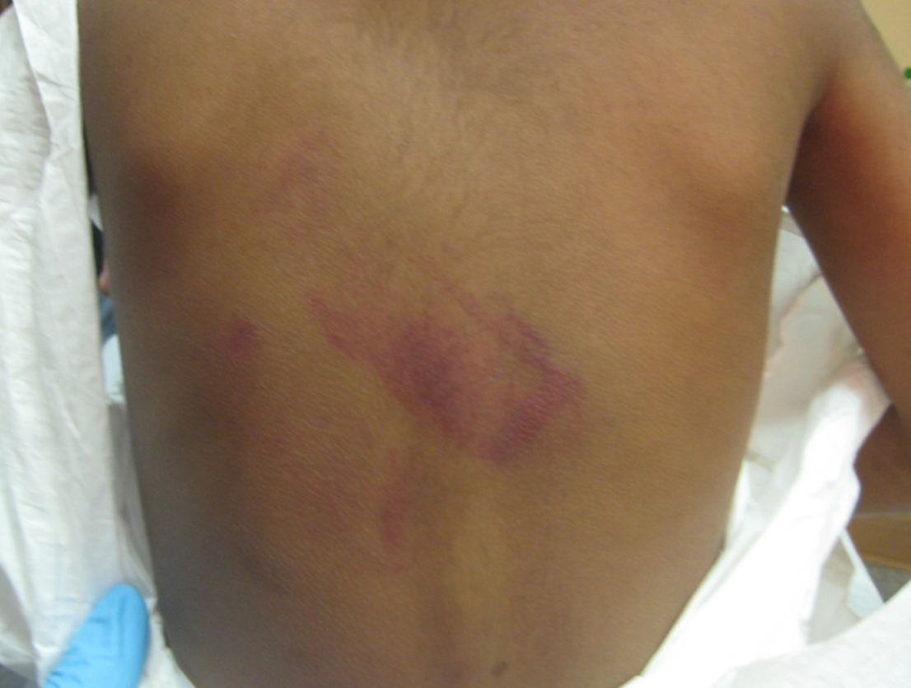
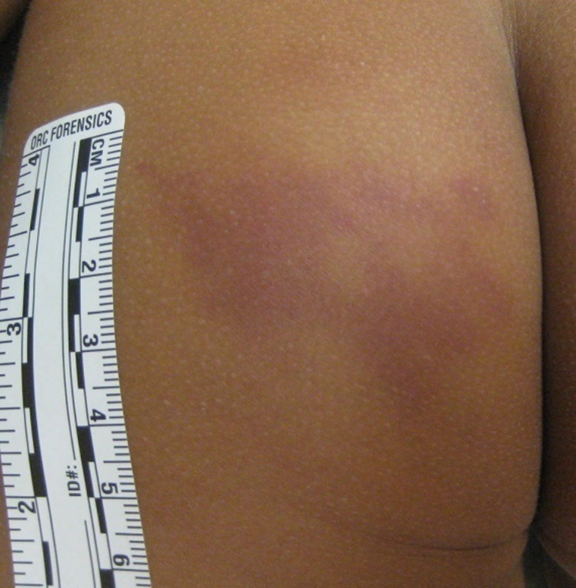
Patterned Bruises
Loop Marks
Belt Marks
Spatula Marks
Loop marks are caused by an implement (eg, belt, rope, extension cord) that is bent double and used to strike the skin.
Belt marks can be loops or rectangles depending on the surface that impacts the skin.
Medical practitioner may not be able to identify the object but can appreciate the presence of a patterned outline.
©2016 American Academy of Pediatrics

Slide 70
Pinch Mark
Forceful pinching is a form of excessive discipline.
Unrealistic expectations for child development are a risk factor for child physical abuse.
Another area where pinch marks occur are the ears. Looking for bruising of the helix and behind the pinna can be helpful in identifying child physical abuse.
©2016 American Academy of Pediatrics

Slide 71
Burns

Slide 72
Thermal Burns: Scald, Splash/Spill
Child falls into hot cooking liquid.
Toddler with an immersion pattern burn.
Family had taken a recently boiling pot of chicken off of the stove and placed it on the floor.
Child ran in, saw chicken in bottom of pot, and stuck her arm into the boiling water, so it took a second before she pulled her hand out.
Used by permission from AAP
©2016 American Academy of Pediatrics

Slide 73
Thermal Burns: Scald, Immersion
Child is placed into or enters a hot liquid.
Most commonly water in a sink or bathtub.
Classic patterns of “glove” or “stocking” appearance.
Consistent depth, clear line of demarcation
Also involves lower limbs or perineum/buttocks with doughnut-shaped sparing where buttocks presses up against cool bottom of sink or tub.
Skinfold sparing where child was flexed during event.
©2016 American Academy of Pediatrics

Slide 74
Immersion burns located perineum, buttocks and extremities very concerning for abuse
©2016 American Academy of Pediatrics

Slide 75
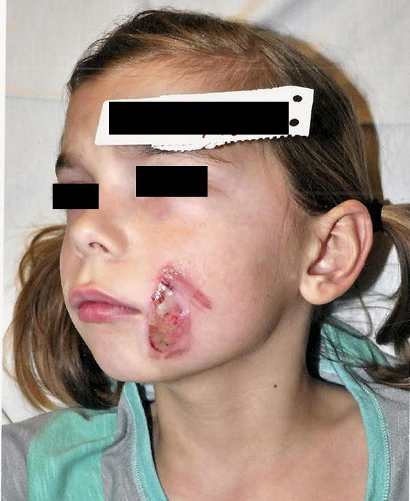
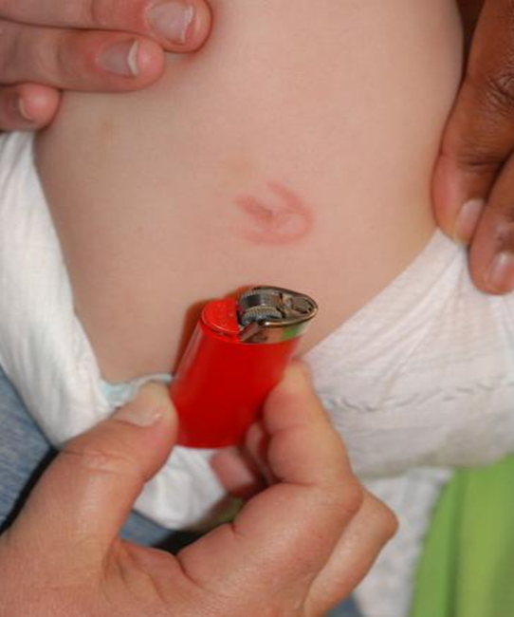
Thermal Burns: Contact
Possible objects
Iron, curling iron, hair straighteners
Cigarette burns: circular, approximately 1 cm in diameter
Can be confused with impetigo.
Impetigo lesions heal without scarring, usually have scaling around lesion; culture of lesion reveals causative organism.
Car seat
In toddlers, usually occurs on palm of hand
Concerning for abusive burn
Full-thickness burn
Affects back or neck
Clear edges of demarcation
©2016 American Academy of Pediatrics

Slide 76
Chemical Burns Electrical Burns
Mechanism: direct chemical reactions with tissues
Common non-abusive mechanism: exploratory tasting
Acid
Cause coagulative necrosis, which limits depth of injury
Common examples: drain cleaners (sulfuric and hydrochloric acid), car batteries (sulfuric acid)
Alkaline
Cause liquefactive necrosis, which causes deeper penetration of injury
Can increase likelihood of gastrointestinal perforation
Common examples: lye (sodium hydroxide), oven and drain cleaners (sodium and potassium hydroxide)
Bleach
Can have distinct red-brown discoloration
Account for 3%–9% of admissions to burn centers.
Types
Low voltage (<1,000 V), eg, biting electrical cord
High voltage (>1,000 V), eg, power lines, lightning strikes
Visible areas usually only show a small portion of the tissue destruction.
Multiple serious morbidities
Contractures of oral commissures
Permanent defects
Compartment syndrome, possibly leading to amputations
Cardiac arrhythmias, possibly leading to cardiac arrest
©2016 American Academy of Pediatrics

Slide 77
Red Flags in Inflicted Burns
Inconsistent history
Changing history
Incompatible with developmental level
“Magical” burn—appeared one day
Young age of child (<5 years)
Pattern burn
Symmetric distribution
Immersion
Multiple burns
Genital burns
Deeper or large surface area burn
Difficult developmental milestones
Toileting accidents during toilet training
Other suspicious injuries
Bruising
Fractures
Delay in seeking care
Unacceptable vs acceptable
©2016 American Academy of Pediatrics

Slide 78
Non-abuse or Abuse?
It has been estimated that burns from neglect compared with intentional burns occur at rate of 9:1 (Maguire 2010).
Can the child climb into the bathtub?
Allasio and Fischer (2005) studied a group of 176 infants and children, aged 10–18 months.
35% of the infants/children could climb into the bathtub.
How long does it take to cause a full-thickness burn?
Moritz and Henriques (1947) studied time to cause full-thickness burn in adults.
10 minutes at 48.9°C (120°F); 2 minutes at 51.7°C (125°F)
30 seconds at 54.4°C (130°F); 2 seconds at 65.6°C (150°F)
Likely takes even shorter times to cause full-thickness burns in children.
©2016 American Academy of Pediatrics

Slide 79
Prevention
Non-abusive burns are largely preventable.
Education of caregivers
Water heaters set at 48.9°C (120°F)
Safe storage of chemicals
©2016 American Academy of Pediatrics

Slide 80
Fractures

Slide 81
Abusive Fractures
Children with abusive fractures are often too young to provide history.
The history may be lacking or intentionally misleading.
Missed abusive fractures can result in repeated abuse, sometimes with devastating consequences.
Misidentifying a non-abusive fracture as abusive can have detrimental effects for the patient and family.
©2016 American Academy of Pediatrics

Slide 82
Epidemiology
Reported prevalence of fractures due to abuse varies across studies.
Kemp (2008) meta-analysis
25%–56% of fractures in children younger than 1 year due to abuse
Worlock (1986)
80% of abusive fractures are in children younger than 18 months, and 85% of non-abusive fractures are in children older than 5 years.
74% of abused vs 16% of non-abused with 2 or more fractures.
Annual incidence 4 per 10,000 younger than 18 months.
©2016 American Academy of Pediatrics

Slide 83
Epidemiology
Leventhal (2008)
Abuse accounts for about 12% of children younger than 36 months hospitalized with fractures.
Incidence: 15.3/100,000
Incidence decreases as age increases.
36.1/100,000 younger than 12 months (24.9% of fractures)
4.8/100,000 12–23 months (7.2% of fractures)
4.8/100,000 24–35 months (2.9% of fractures)
©2016 American Academy of Pediatrics

Slide 84
Fractures- normal part of childhood…
and common in abuse
Up to 66% of boys and about 40% of girls will sustain a fracture by their 15th birthday
85% of accidental fractures are seen in children over 5 years
Fractures occur in 25% of abuse children
80% of abusive fractures are seen in children less than 18 months of age
20% of children with abusive fractures has at least one prior visit where abuse was missed.
©2016 American Academy of Pediatrics

Slide 85
Fracture Specificity
Any fracture can be the result of abuse.
No fracture is pathognomonic of abuse.
Some fractures, however, have greater specificity for abuse.
Diagnosis relies on more than fracture specificity.
History (or lack of history)
Age and development of child
Other examination findings
Consideration and elimination of underlying medical conditions
Investigation by community professionals such as law enforcement and social services
©2016 American Academy of Pediatrics

Slide 86
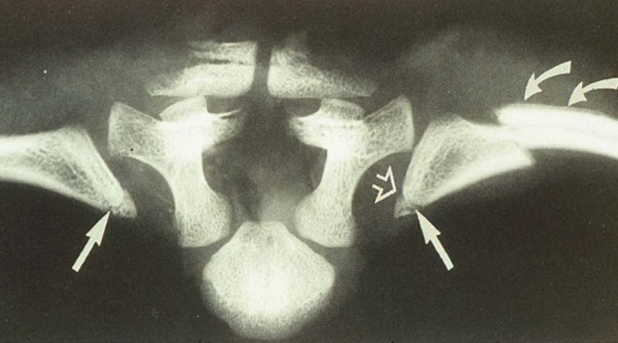
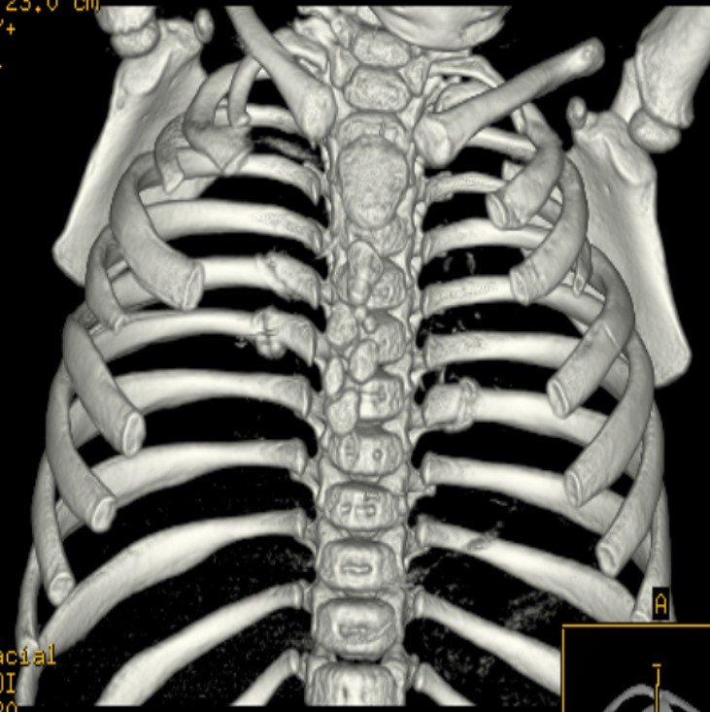
High Specificity
Rib fractures, especially posterior
Relatively common in child abuse
90% seen younger than 2 years
Posterior rib fractures involve
Rib head: costovertebral articulation
Rib neck: costotransverse process
articulation
CMLs
Scapular fractures
Spinous process fractures
Sternal fractures
©2016 American Academy of Pediatrics

Slide 87
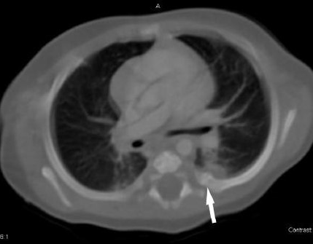
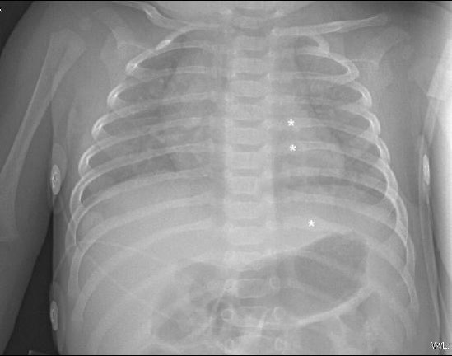
Rib Fractures
Posterior rib fractures may be difficult to recognize. Non-displaced acute rib fractures are often difficult to see radiographically, especially in the posterior location. Only with displacement or when callus formation is present do the fractures become obvious. The amount of callus and the degree of remodeling also affect recognition.
©2016 American Academy of Pediatrics

Slide 88
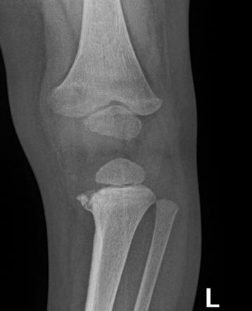
Classic Metaphyseal Lesion (CML)
“Bucket handle” or “corner fractures” are the same as CMLs and long known to be associated with abuse
Requires shearing forces not typically produced in non-abusive trauma.
Possibly produced during shaking where limbs flail about.
Also consider twisting and jerking.
Has been seen in infants undergoing manipulation and casting for clubfoot deformity.
©2016 American Academy of Pediatrics

Slide 89
Moderate Specificity
Common, but Low Specificity
Multiple fractures, especially bilateral
Fractures at different ages
Epiphyseal separations
Vertebral body fractures/subluxations
Digit fractures
Subperiosteal new bone formation.
Clavicle fractures.
Long bone shaft fractures.
Skull fractures.
Low-specificity fractures may be strong indicators of abuse in the appropriate clinical setting (eg, no trauma history in a nonmobile baby).
©2016 American Academy of Pediatrics

Slide 90
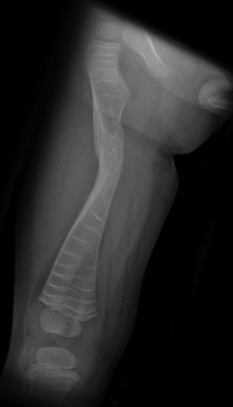
Diseases Simulating Fractures
Spina bifida/neuromuscular disease
Osteomyelitis
Congenital syphilis
Rickets
Scurvy
Vit. A intoxication
Caffey’s disease
Leukemia
Copper deficiency
Menke’s syndrome
Drugs: Prostaglandin E, Methotrexate
Metaphyseal & spondylometaphyseal dysplasia
Osteogenesis Imperfecta
©2016 American Academy of Pediatrics

Slide 91
Myths About Fractures
Myth: Spiral fractures are nearly always abusive.
Fact: Spiral fractures can be non-abusive.
Myth: Babies’ bones break easily.
Fact: It takes significant force to break an infant’s bones.
Myth: There should be bruises over inflicted fractures.
Fact: About 60% of fractures have no bruises.
Fact: 26% sensitivity to predict abusive fracture.
Peters (2008)
Valvano (2009)
©2016 American Academy of Pediatrics

Slide 92
Evaluation & reporting

Slide 93
Evaluation of Possible Abuse
Is there a plausible explanation?
If no, consider
Skeletal survey in children younger than 2 years
Repeat skeletal survey 2 weeks after initial survey
Head computed tomography (CT) scan in infants younger than 6 months and those with abnormal neurologic findings
Dilated ophthalmologic examination when AHT is suspected
Laboratory studies to screen for abdominal injury
Screening for occult drug injury
Screening for predisposing conditions, such as bleeding diatheses, if bruising is present
©2016 American Academy of Pediatrics

Slide 94
Skeletal Survey
Skull: frontal and lateral views
Spine: frontal, lateral thoracolumbar spine (including sternum)
Chest: frontal and lateral
Extremities
Upper: frontal to include shoulders and hands
Lower: frontal to include lower lumbar spine, pelvis, feet
Skull: frontal and lateral views
The skeletal survey is the primary imaging study for suspected child abuse in children younger than 2 years.
Must comply with standards developed by the American College of Radiology.
19 separate radiographic exposures.
“Babygram” not acceptable.
Ideally read by pediatric radiologist.
Skeletal survey should be repeated 2 weeks post-injury
©2016 American Academy of Pediatrics

Slide 95
Evaluation of Sentinel Injuries
“If no additional injury is detected on skeletal survey or head CT in an infant with a history or exam finding of a sentinel injury, abuse remains the primary diagnostic consideration because the sentinel injury may be the first and only injury from abuse. Therefore, a history or an exam finding of a sentinel injury should prompt a report to authorities for suspected abuse.” (Sheets 2013; Petska 2014)
©2016 American Academy of Pediatrics

Slide 96
General Protective Services
Neglect
Truancy
Inappropriate discipline
Hygiene issues
Abandonment
©2016 American Academy of Pediatrics

Slide 97
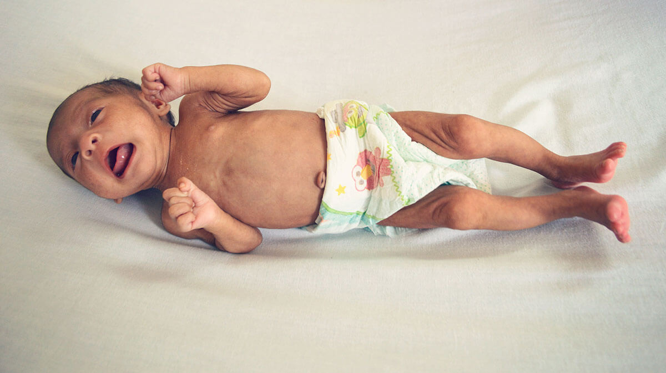
When Should Neglect be Considered?
Failure to thrive
Medical problems not addressed
Delay in seeking care
Extreme lack of cleanliness
Inappropriate clothing for environment
Special health care needs not addressed
Truancy without medical explanation
©2016 American Academy of Pediatrics

Slide 98
Shared by Children & Youth
Final status of GPS assessment
Final status of child abuse investigations (CPS)
Services provided or arranged
Other certified medical practitioner(s)
ChildLine will notify mandated reporter via mail on CPS investigation outcome/services.
©2016 American Academy of Pediatrics

Slide 99
Reporting to CPS is Hard, But Remember…
Any parent or caregiver may momentarily lose control.
People other than parents may have abused the child.
Safety of the child is paramount.
Only mandated to report suspicion (do not need to have diagnostic certainty).
Missing abuse could lead to escalation of abuse and even death.
Reporting may be the only opportunity to prevent further abuse.
You can explain to the family in a nonjudgmental way that further testing is standard medical care and reporting is mandated by law.
©2016 American Academy of Pediatrics

Slide 100
Medical Approach to Reporting
Physical
Exam
Initial thought-
“Could this be abuse?”
History
X-rays
Labs
Observed
Interaction
Making a report-
“Reasonable cause to suspect”
ChildLine
©2016 American Academy of Pediatrics

Slide 101
Protective Custody
“… physician may take a child into protective custody if it is immediately necessary to protect the child from further serious physical injury, sexual abuse, or serious physical neglect.”
©2016 American Academy of Pediatrics

Slide 102
Make a report to ChildLine
File the report electronically
https://childabuse.illinois.gov/
or
Call 1-800-932-0313
©2016 American Academy of Pediatrics

Slide 103
Statement of Concern- be specific
Name, age, sex of child; date seen, reason for presentation. Then,
These injuries are (circle one):
Concerning for physical abuse
Highly concerning for physical abuse
Diagnostic of physical abuse
The injuries caused (circle if applicable):
Substantial pain
Impairment of function
Current status (discharged/admitted; siblings to be evaluated)
Injury consistent with history provided by caretake?
Yes/No/Possibly/Unknown
©2016 American Academy of Pediatrics

Slide 104
Prevention
Providing anticipatory guidance
Patient handouts
Purposeful parenting
Protective factors
“It is easier to build strong children than to repair broken men.”
-Frederick Douglas (1817-1895)
©2016 American Academy of Pediatrics

Slide 105
Thank you for attending!
Must complete evaluation for Act 31
For more information:
https://dcfs.illinois.gov/safe-kids/reporting.html
©2016 American Academy of Pediatrics

