Slide 1
Vitamin C and Cortisol Optimize healing and optimize the immune system
Sev Hrywnak, D.P.M., M.D.

Slide 2
No conflicts of Interest

Slide 3
PRESENTATION OVERVIEW
Pathophysiological basis of all disease
Regulators of intracellular oxidative stress
Promotors of all disease
Foundational disease treatment principles
Pivotal role of vitamin C in health and disease
Cortisol interrelation with vitamin C
Normal mammalian response to acute oxidative stress
Cortisol deficiency is probably more common than other treated hormone deficiencies(estrogen, testosterone, thyroid)
The importance of insulin in vitamin C metabolism
Is the Krebs cycle the evolutionary response to GULO absence

Slide 4
Reference Checking
Go to: www.ncbi.nlm.nih.gov/pubmed
In pubmed search box, enter the 7 digit or 8 digit number that is noted on a slide. This is the pubmed (PMID) identifier number.
Click “Search” and you will go directly to the abstract of article.
Ex: ( 76642895)

Slide 5
It is all about the cell, Cell Biochemistry
“Normal Cell Metabolism is the basis of not only a healthy life but the foundation to prevent and fight diseases”
Stephen J. Murphy, M.D. University of Chicago 1964
Cells >>>>>> Tissues >>>>>>> Organs

Slide 6
The cause of all disease: a unified theory
Increased Intracellular
Oxidative Stress (IOS)
IOS
IOS
IOS
(16760481)

Slide 8
Redox medicine principles 1
Synonyms
Pro-Oxidant: Toxins
Free radicals
Reactive oxygen species (ROS)
Antioxidant: Vitamin C

Slide 9
Redox medicine principles 2
Properly Administered Vitamin C
Has NEVER failed
To neutralize an acute
Pro-oxidant/poison/toxin
exposure or ingestion

Slide 10
Redox medicine principles 3
*Toxicity and any symptoms
Of toxicity cannot
Exist in the absence of
Oxidation
(depletion of electrons from Biomolecules)

Slide 11
Redox medicine principles 4
Oxidative stress does not “cause” disease
But
Is the disease process itself!

Slide 12
Redox medicine principles 5
Type
Quantity
Location
Concentration
Length of time

Slide 13
Redox medicine principles 6
Goal to normalize as completely as possible the increased
IOS (intracellular oxidative stress)
Need normal levels of:
VIT C
Calcium
Magnesium
Getting these 3 normalized will cause the return of
Normal glutathione levels

Slide 14
Intracellular Oxidative Stress Modulators
IOS is the “sine qua non” of all illness
Primary determinants of IOS status
Calcium
Magnesium
Vitamin C
Glutathione

Slide 15
Intracellular Oxidative Stress Modulators
Calcium
Primary determinant and marker of
Increased IOS
Control intracellular calcium levels
And you can control
Positively IOS

Slide 16
Intracellular Oxidative Stress Modulators
Calcium
Increased calcium intake by both supplemental and dietary sources DRAMATICALLY increases death from any disease (23403980)
Calcium supplementation alone shown to significantly increase risk of a myocardial infarction (22626900) (20671013)

Slide 17
Intracellular Oxidative Stress Modulators
Magnesium
CALCIUM MAGNESIUM

Slide 18
Intracellular Oxidative Stress Modulators
Magnesium
Extra magnesium DECREASES death from any diseases (18271493) (21703623)

Slide 19
Intracellular Oxidative Stress Modulators
VITAMIN C
CALCIUM + MAGNESIUM
= low vitamin C levels

Slide 20
Intracellular Oxidative Stress Modulators
GLUTATHIONE
Major role in shielding cellular molecules from reactive oxygen species (Peroxides, Superoxide, Radicals,)
Also
Regulates cellular proliferation and apoptosis vital to mitochondrial function and maintenance of mitochondrial DNA

Slide 21
Hormones and oxidative stress
Positively modulate normal metabolism
Normalize increased intracellular oxidative stress

Slide 22
Hormones and oxidative stress
Insulin
Cortisol
Thyroid Hormones
Sex hormones :( regulate Redox status and mitochondrial function)

Slide 23
The final common denominator
Remember that the goal of an optimally effective clinical protocol is to
NORMALIZE
The increased IOS that is present in all cells involved in any disease or medical condition

Slide 24
Prominent promoter of chronic degenerative diseases
Infections
Chronic pathogenic colonization
Toxin exposure
Toxic nutrients
Dietary toxin exposure
Critical hormone deficiencies

Slide 25
Treatment principles for all chronic degenerative diseases
Prevention
Neutralize
Excrete
Resolve
Supplement
Address

Slide 26
Vitamin C – proven to do
Kill/inactivate all viruses in vitro
Resolve all acute viral syndromes in vivo with adequate dosing
- Polio
- Hepatitis

Slide 27
Vitamin C – proven to do
Measles
Mumps - (18147027)
Chickenpox – (14908970)

Slide 28
Vitamin C – proven to do
Diphtheria
Tetanus
Staphylococcus
Streptococcus
Pseudomonas
Malaria
Leprosy

Slide 29
Vitamin C – proven to do
Benefits:
Lyme Disease
AIDS
Common cold
Tuberculosis

Slide 30
What has vitamin C already been proven to do against toxins?
Documented as the ultimate non-specific antitoxin and poison antidote in vitro and in vivo
Toxic elements
Venoms
Alcohol (3304067)
Barbiturates (5899011)
Toxic mushrooms (6200941)
Pesticides
Strychnine, tetanus

Slide 31
Vitamin C and toxins
Its all about the dosage!

Slide 32
Properly dosing Vitamin C
150,000 IV infusions of vitamin C
Doses have varied from 7.5 to 250 grams daily
There has never been establishes a level of vitamin C intake above which is clearly toxic

Slide 33
Properly dosing Vitamin C
Caution on dosing leads to insufficient results

Slide 34
Optimizing intracellular vitamin c
Cortisol (hydrocortisone) promotes cellular update of vitamin C (11502226)

Slide 35
Optimizing intracellular vitamin c
Chronic degenerative disease patients are at least minimally deficient in cortisol production from their adrenal glands

Slide 36
vitamin c and cortisol
Cortisol works directly to substantially enhance the uptake of vitamin C into the cell
(28739448) (26351497) (16338599)

Slide 37
vitamin c and cortisol
Acute infection and toxin exposure results in oxidative stress which results in the prompt release of cortisol into the blood
This event should be matched by a large release of vitamin C

Slide 38
vitamin c and cortisol
First line treatment of a new infection:
Large doses of vitamin C matched with sizeable doses of cortisol
Example:
5 grams of vitamin C plus
20 mg of hydrocortisone QID

Slide 39
Optimizing intracellular vitamin c
Early stage of an infection (23933016)

Slide 40
vitamin c and the acute immune response
Acute inflammation
Depletion
First immune cell to arrive (29045897)
Monocyte

Slide 41
Cortisol release
Increased cortisol
Glutathione
Restore vitamin C

Slide 42
Hydrogen peroxide (HP) and vitamin c physiologic partners
Fenton reaction
Upregulation of HP production (16157892)
Increase cortisol levels (14499666)

Slide 43
“fight or flight” response results from Vitamin C / cortisol synergism
Vitamin C is synthesized 24/7 from liver stores of glucose
Large amounts of vitamin C synthesized when triggered by a large pro-oxidant presence (infection)

Slide 44
The human liver
Vitamin C cannot be synthesized because of an acquired epigenetic defect
Infants make their own vitamin C then gradually lose the ability (4830116)

Slide 45
hydroxytyrosol
A powerful polyphenol found naturally in olives
The only polyphenol that crosses the blood brain barrier, which allows it to have significant action to scavenge free radicals in their nervous system
Has anti-inflammatory activity, anti-microbial, anti-thrombotic effect and is cardio protective
Taking hydroxytyrosol, when ingesting large quantities of alcohol (toxin) resulted in prompt and dramatic increase in vitamin C

Slide 46
“flight or flight” what SHOULD HAPPEN?
Large oxidative stress in the blood causing an:
Adrenal release of cortisol
Increased intracellular vitamin C
Increased cortisol-induced glucose synthesis
Continues until the oxidative stress is resolved

Slide 47
But what does happen?
In The Typical Human
Oxidative stress triggers cortisol release but NO vitamin C synthesis
Continues cortisol-induced production of new glucose that is NOT used up making new vitamin C

Slide 48
Vitamin c / cortisol synergism clinical takeaways
When cortisol is clinically indicated….
When vitamin C is clinically indicated….
In the short-term….

Slide 49
Glucose, vitamin c, insulin and the krebs cycle:
A Hypothesis
1988772
9550452
3352824
9421397

Slide 50
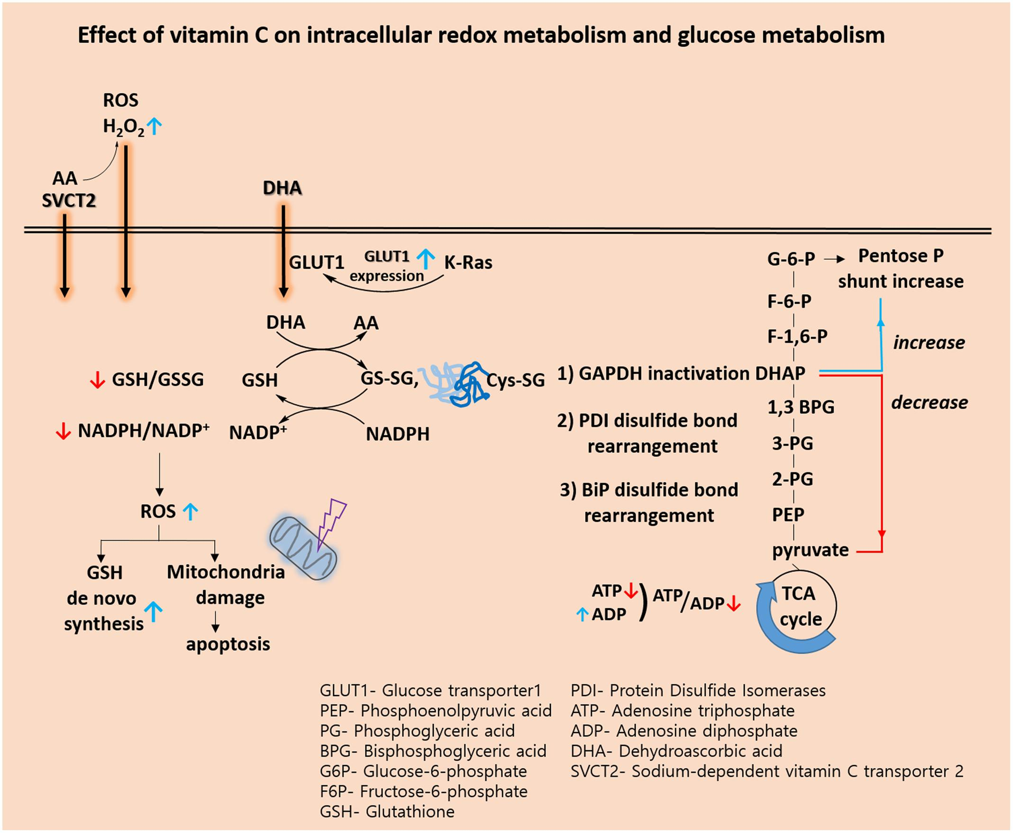

Slide 51
General Suggestions foR Vit c/ cortisol administration
Oral vs IV vs IM vs SubQ

Slide 52
Labs and Treatment approach for wound care HS-CRP, Homocysteine, Magnesium, Thyroid Panel, SHBG, Testosterone, Estradiol, Vit D, PregNenolone, Albumin cortisol
Vitamin C, IV 20-50 Grams ,B Complex capsules, Zinc 20 mg caps, Nitric Oxide caps 10 mg , Hydrocortisone caps 10 mg, Magnesium Glycinate caps 250 mg, Pregnenolone caps 30 mg,
BPC-157 Sub q, Sermorelin Sub q, NAD+

Slide 53
Labs aNd treatment approach for Immune health HS-CRP, Homocysteine, Magnesium, Vitamin D Thyroid Panel, Total Testosterone, SHBG, Estradiol, Prolactin, Aldosterone, Vitamin B12, Folate, IGF-1, Fasting Insulin, Thyroid Antibodies, Hba1c, progesterone lipid panel, tsh, Pregnenalone, Albumin, Amylase, lipase, psa, Cortisol
Vitamins C, D, B-complex, Zinc, BPC-157, NAD+, Pro-Biotic, Saw Palmetto, Copper, Peptides

Slide 54
Thank you

