Slide 1
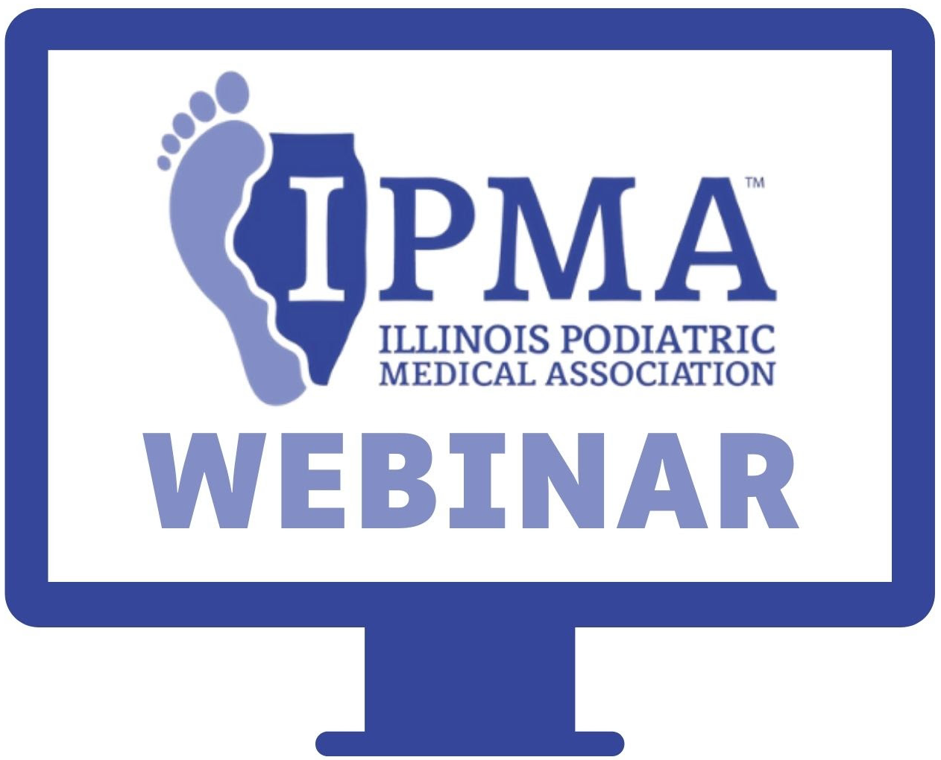
Navigating through complicated surgical cases
Rimi Statkus, DPM, FACFAS
September 13th, 2022

Slide 2
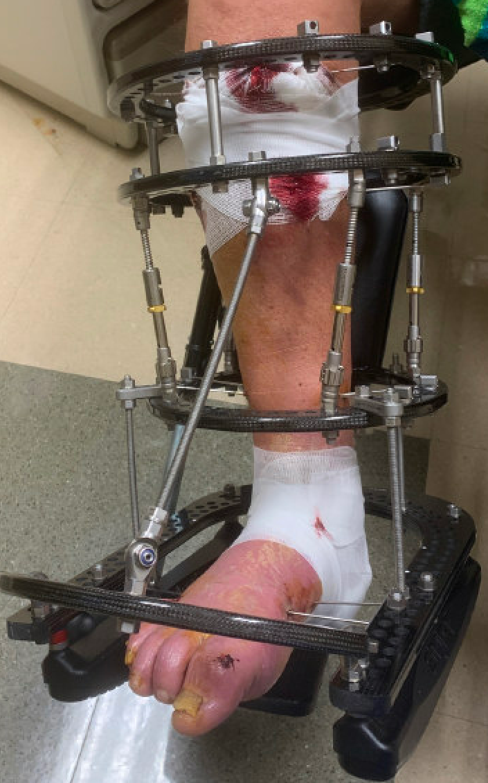
Case Study
55 y.o. male with PMHx DM, neuropathy, HTN, s/p partial L/1-3 ray amputation 2/2 gas gangrene/osteomyelitis. A1c 13 -> 6.7%.
Developed right heel ulcer after excessive walking on vacation. MRI confirmed OM most inferior aspect of calcaneus.
S/p partial resection of calcaneus, adjacent tissue transfer, application of external fixator and IV cefepime per ID recs.

Slide 3
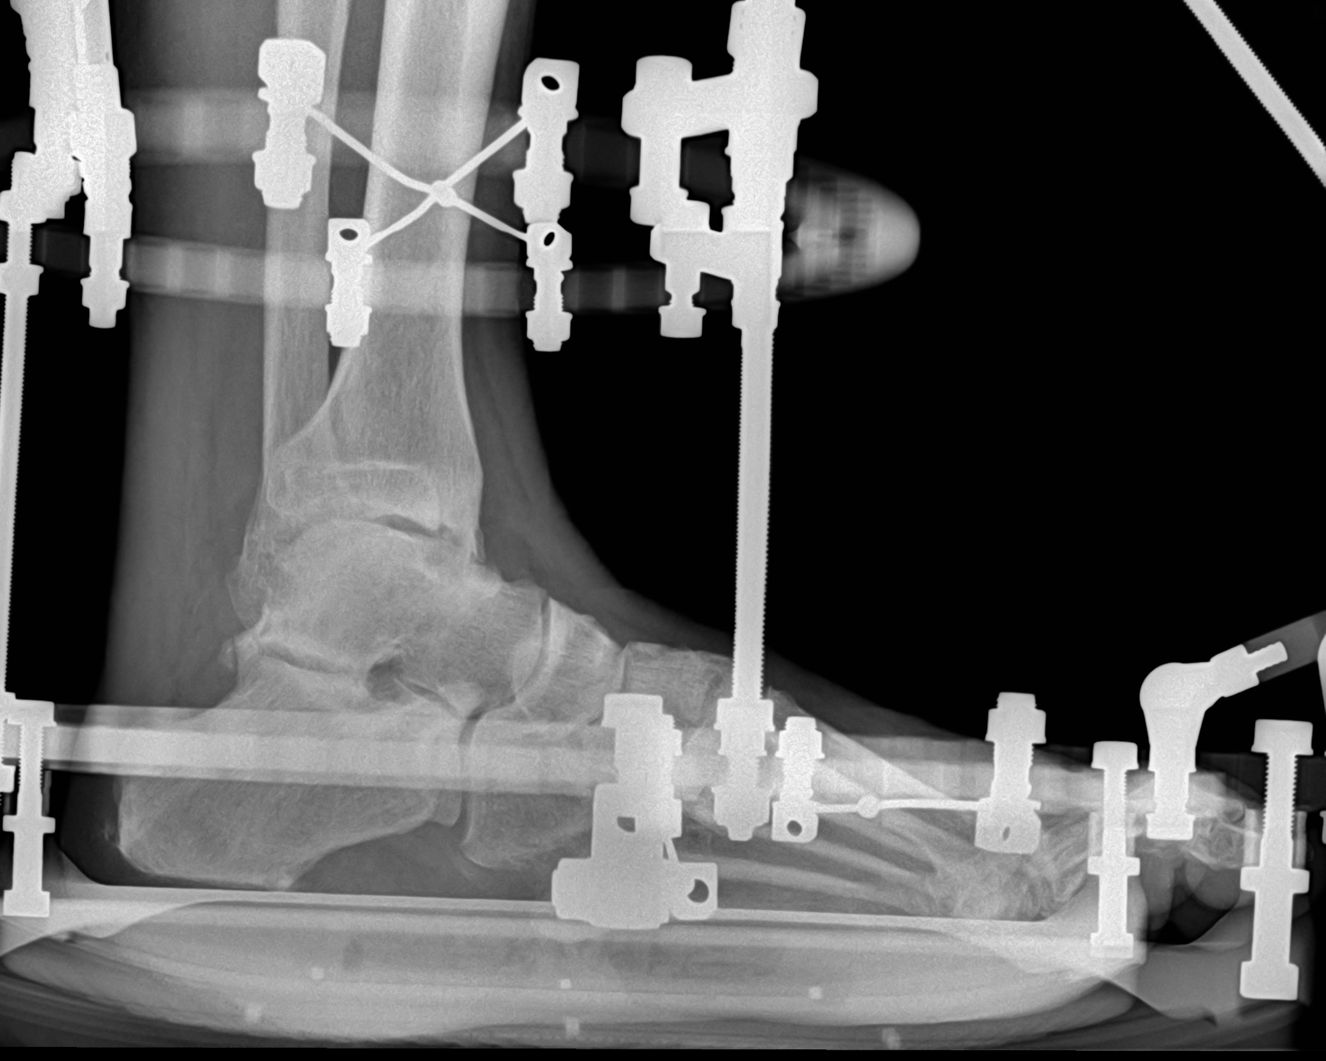
Pathology clearance margin was negative for osteomyelitis.
Ex fix was removed after 6 weeks.
Wound had completely epithelialized, no clinical signs of infection and the patient was ambulating in modified custom orthotic.

Slide 4
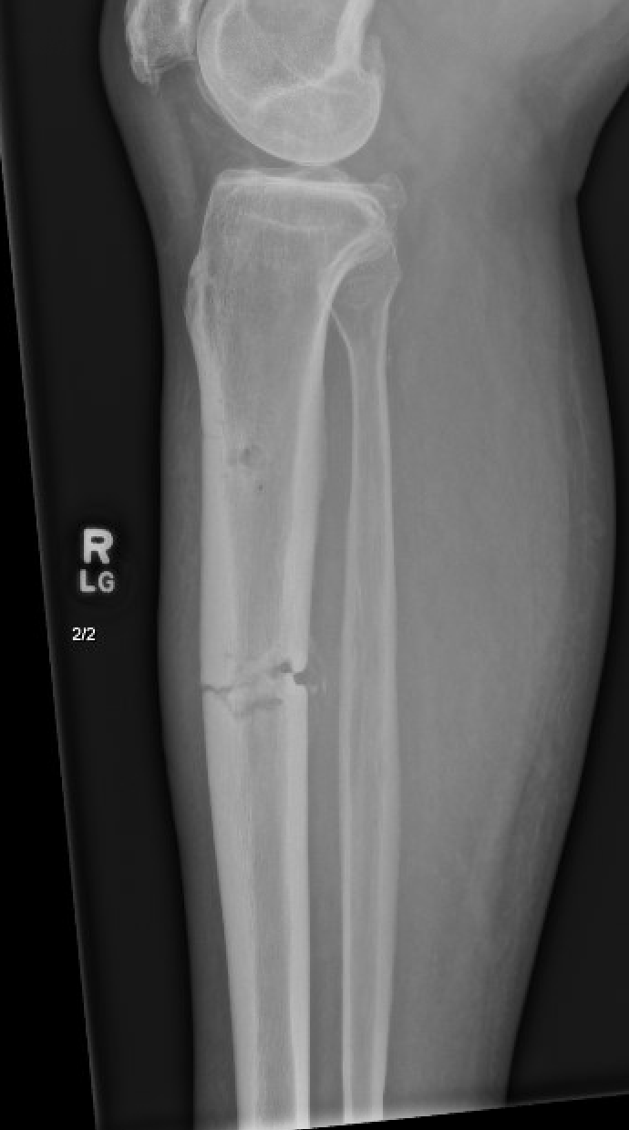
Readmission
4 months later the patient felt a snap and was found on XR to have a midshaft transverse pathologic fracture through the area of the proximal pin site.
Seen by Podiatry and Ortho as inpatient.
Labs: WBC 9, ESR 87, CRP 11.6
MRI findings…
1. Minimally displaced fracture of the proximal tibial diaphysis at the site of the prior screw track with surrounding edema and confluent T1 hypointensity. Findings are consistent with osteomyelitis with surrounding phlegmon. No drainable fluid collection. Edema and enhancement of the surrounding muscles as above which is most likely related to reactive myositis.

Slide 5
MRI
2. Large peripherally enhancing fluid collection on the plantar aspect of the calcaneus representing a soft tissue abscess which extends into and dissects superiorly along the Achilles tendon. There are also MRI findings consistent with osteomyelitis at the plantar/posterior aspect of the heel.
3. Nondisplaced fracture at the distal tibial diaphysis without MRI findings of osteomyelitis.
4. Rounded area of marrow edema, T1 hypointensity at the lateral tibial plafond with signal characteristics suggestive of osteomyelitis.

Slide 6
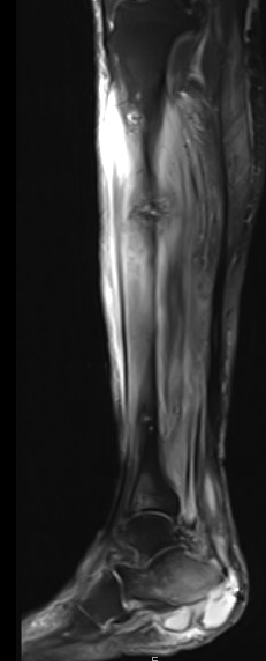
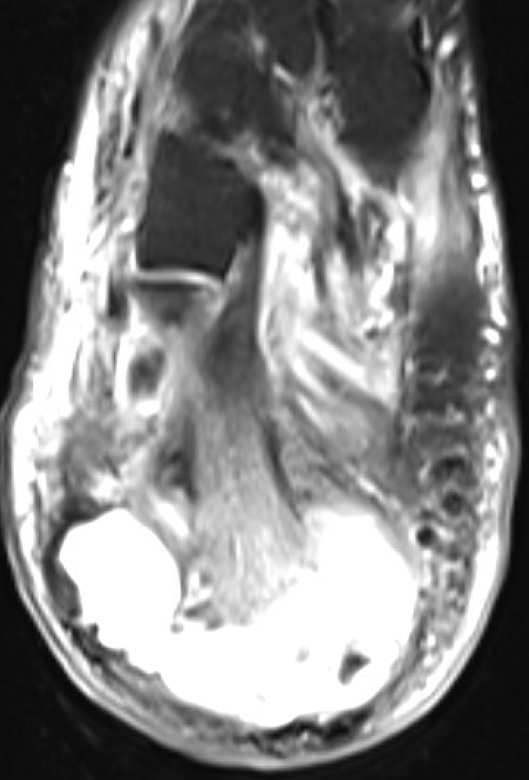

Slide 7
Treatment plan
ID recs for daptomycin and zosyn for 6 weeks.
No open wounds, no leukocytosis.
Seen by Orthopedic traumatologist discussed IM rod placement proximally but with suspected OM calc and abscess formation recommended BKA.
No cellulitis or streaking lymphangitis, no crepitus, mild fluctuance around the calcaneus.
Seen by Podiatrist and another Orthopedic Surgeon.

Slide 8
Limb salvage
Clinically, no overt signs of significant infection distally. After extensive discussions with the patient and Ortho, the plan was for limb salvage with initial I&D, bone biopsy, Achilles debridement. If extensive purulence/abscess formation was found, then bail out would be BKA.
Initial I&D found only seroma formation around the calcaneus. Intra-op cultures and bone biopsies were obtained…

Slide 10
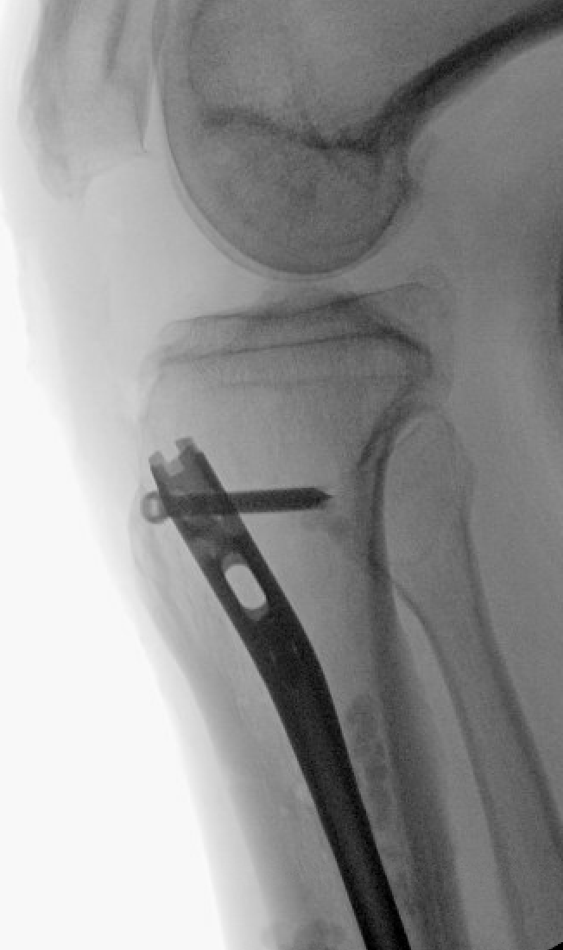
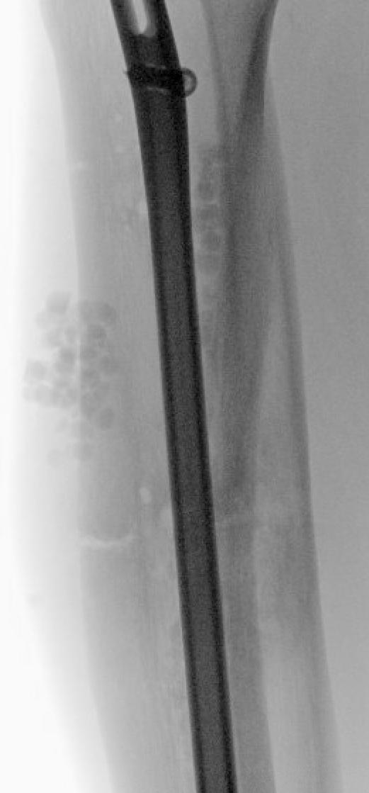
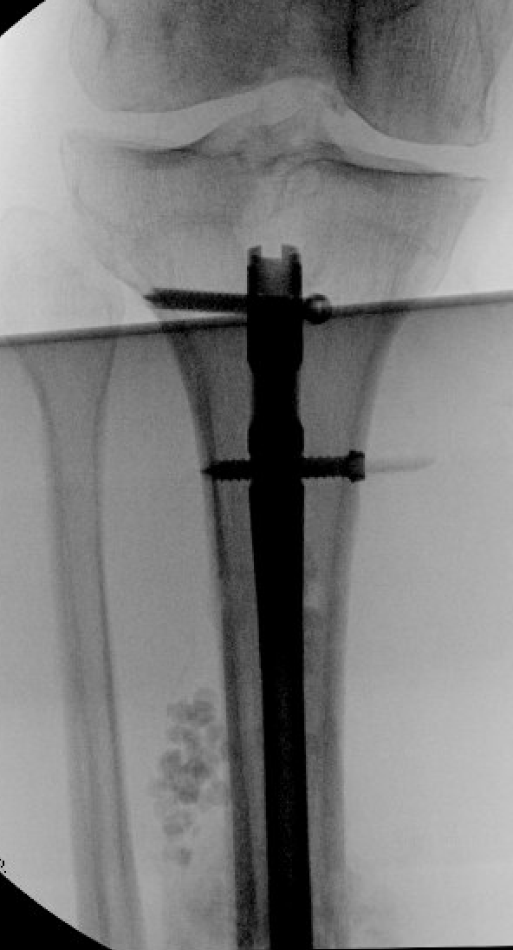
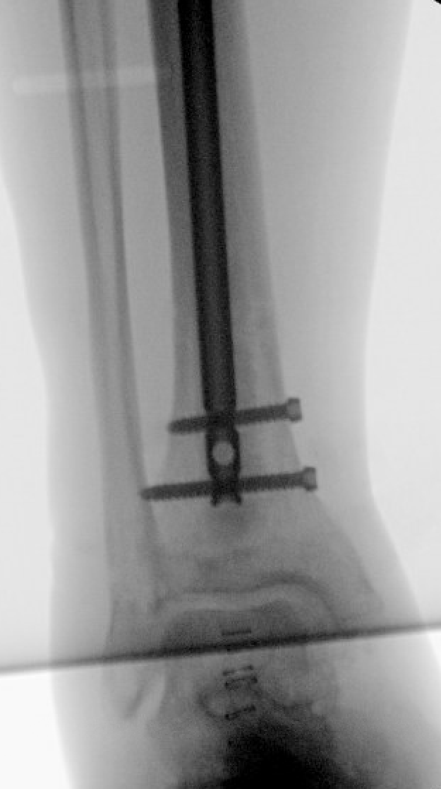
Next staged procedure
Antibiotic intramedullary nailing of tibial shaft fracture

Slide 11
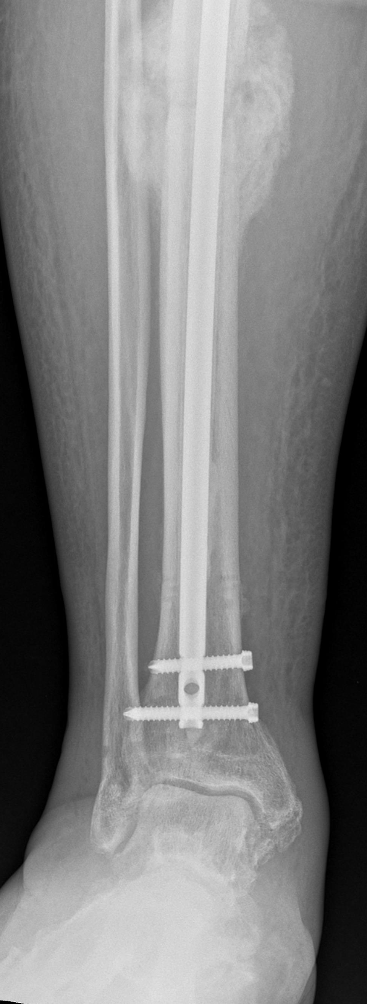
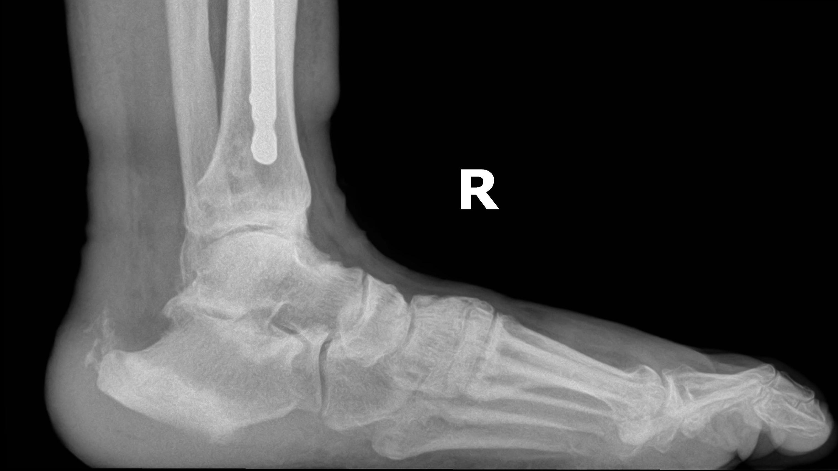
Follow-up
Transitioned from IV to PO abx per ID recs
NWB until incision site healed.
Modified custom orthotics with increased accommodation by Pedorthotist.

