Slide 1
Navigating through Complicated Surgical Cases
Rebecca Stack, DPM, AACFAS

Slide 2
HPI
52 yo male
Presents complaining of pain to the right foot and ankle. Rates 10/10 with ambulation making it difficult to walk. This has developed over the last couple of months. He is a forklift driver, so this makes his job difficult. Admits to being in a MVA in 2007 and experienced several disk herniations in his spine but did not have surgery, believes it was his thoracic spine and denies any symptoms following the accident. Currently also has pain to his left knee and lower back.
Was evaluated in Mexico who recommended he have surgery right away.

Slide 3
History
Medical: HTN, Hyperlipidemia, Arthritis, CKD
Medications: Amlodipine, Carvedilol, Cyanocabalamin, Hydrochlorothiazide, Irbesartan, Simbastatin
Surgical: Hernia repair, left shoulder

Slide 4
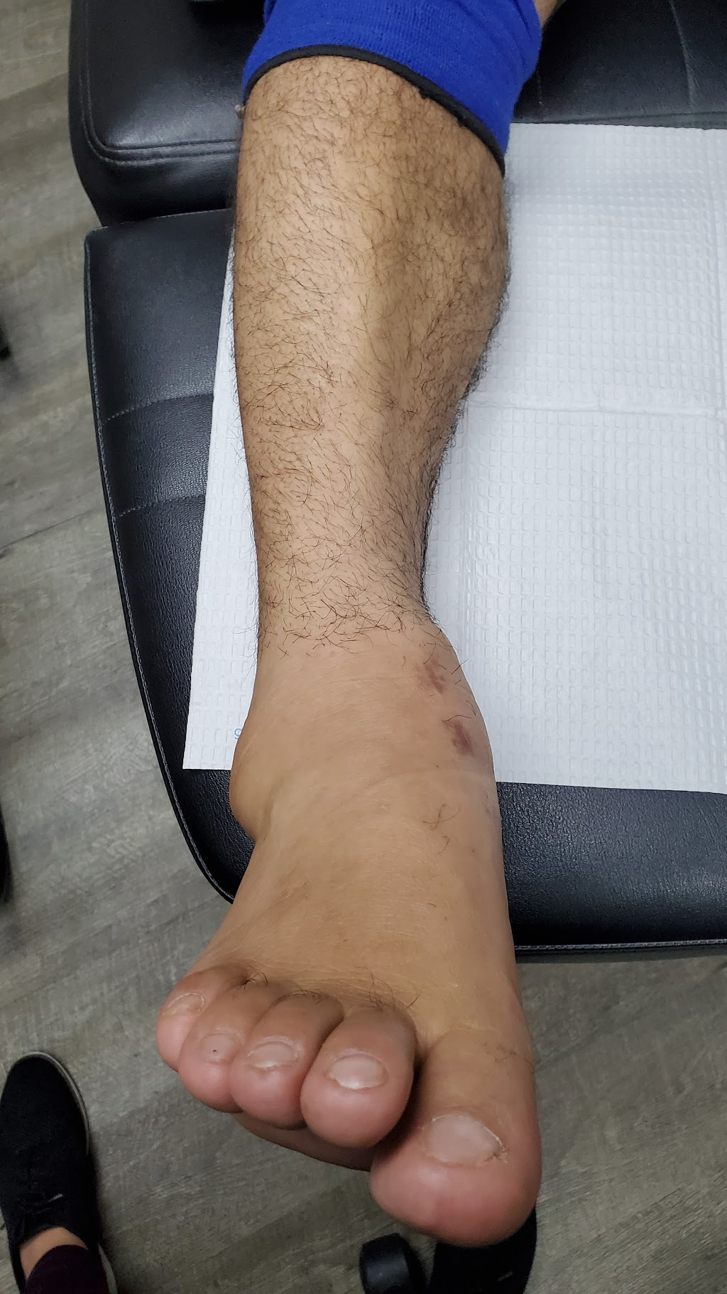
Physical Exam
DP/PT pulses palpable
No open wounds or lesions
Varus deformity noted to ankle with fluid dorsiflexion ROM and reduced plantarflexion ROM.
Mild pain with ROM, most pain exhibited with WB
Sensation intact via monofilament examination

Slide 5
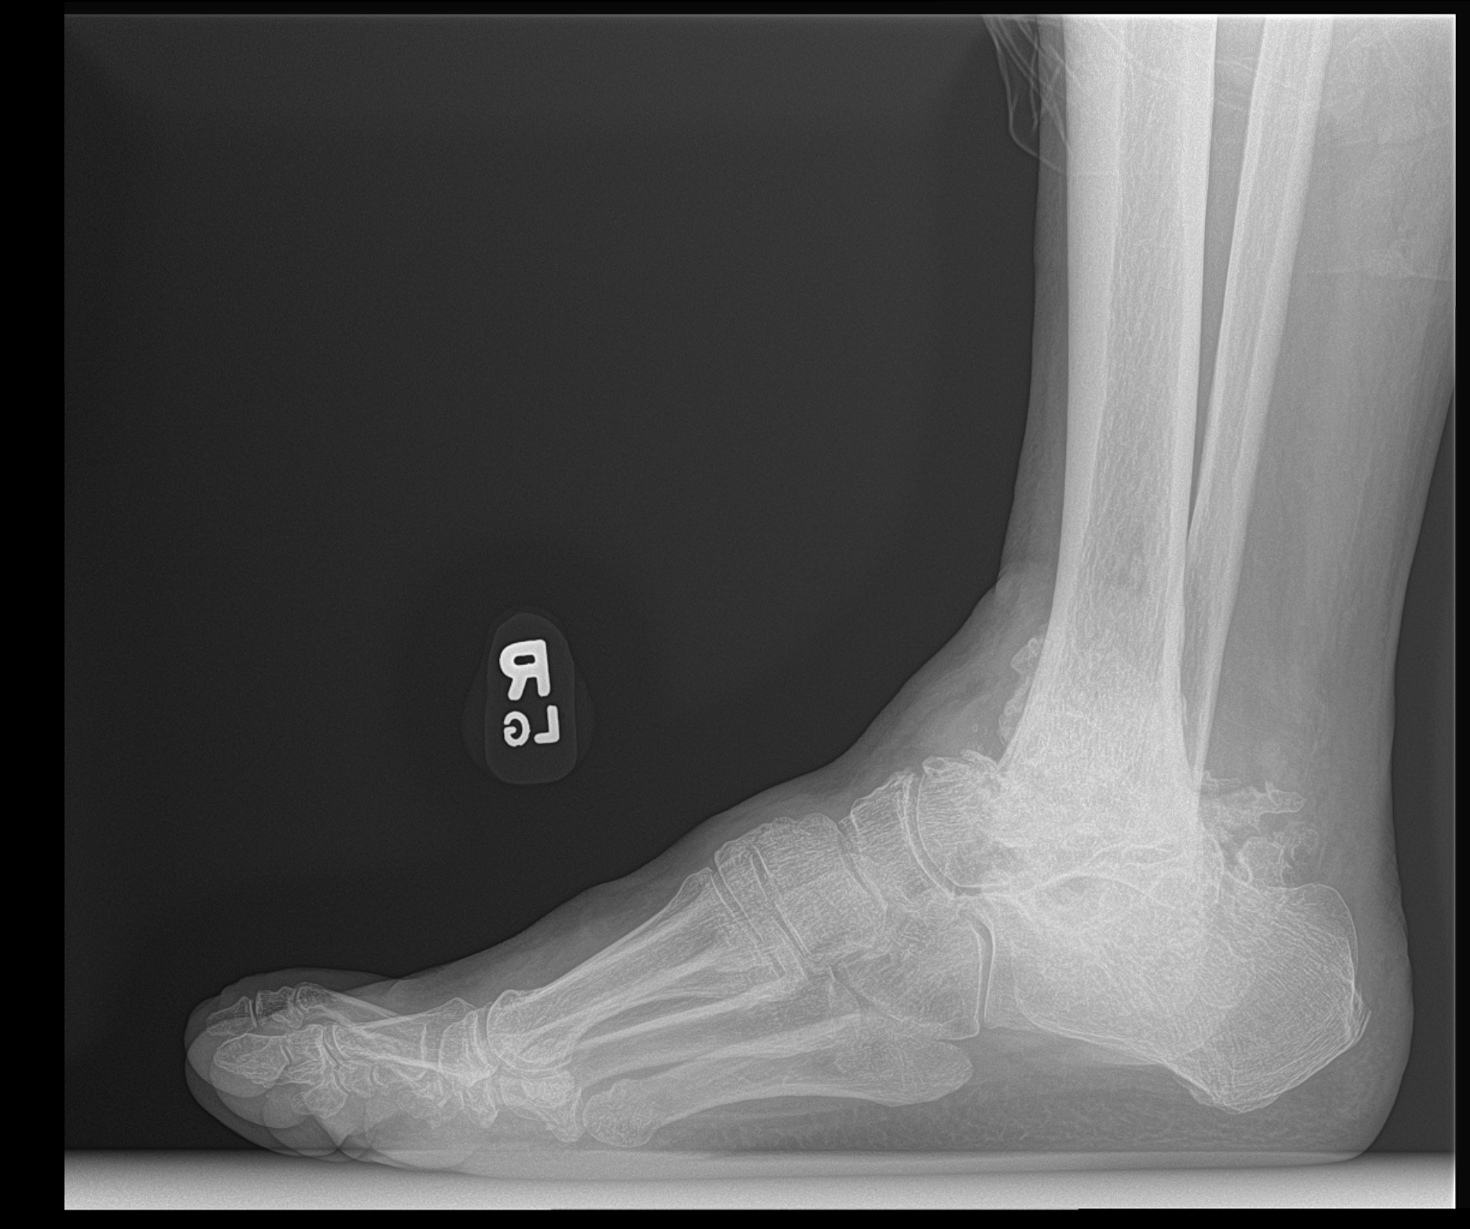
Xrays

Slide 6
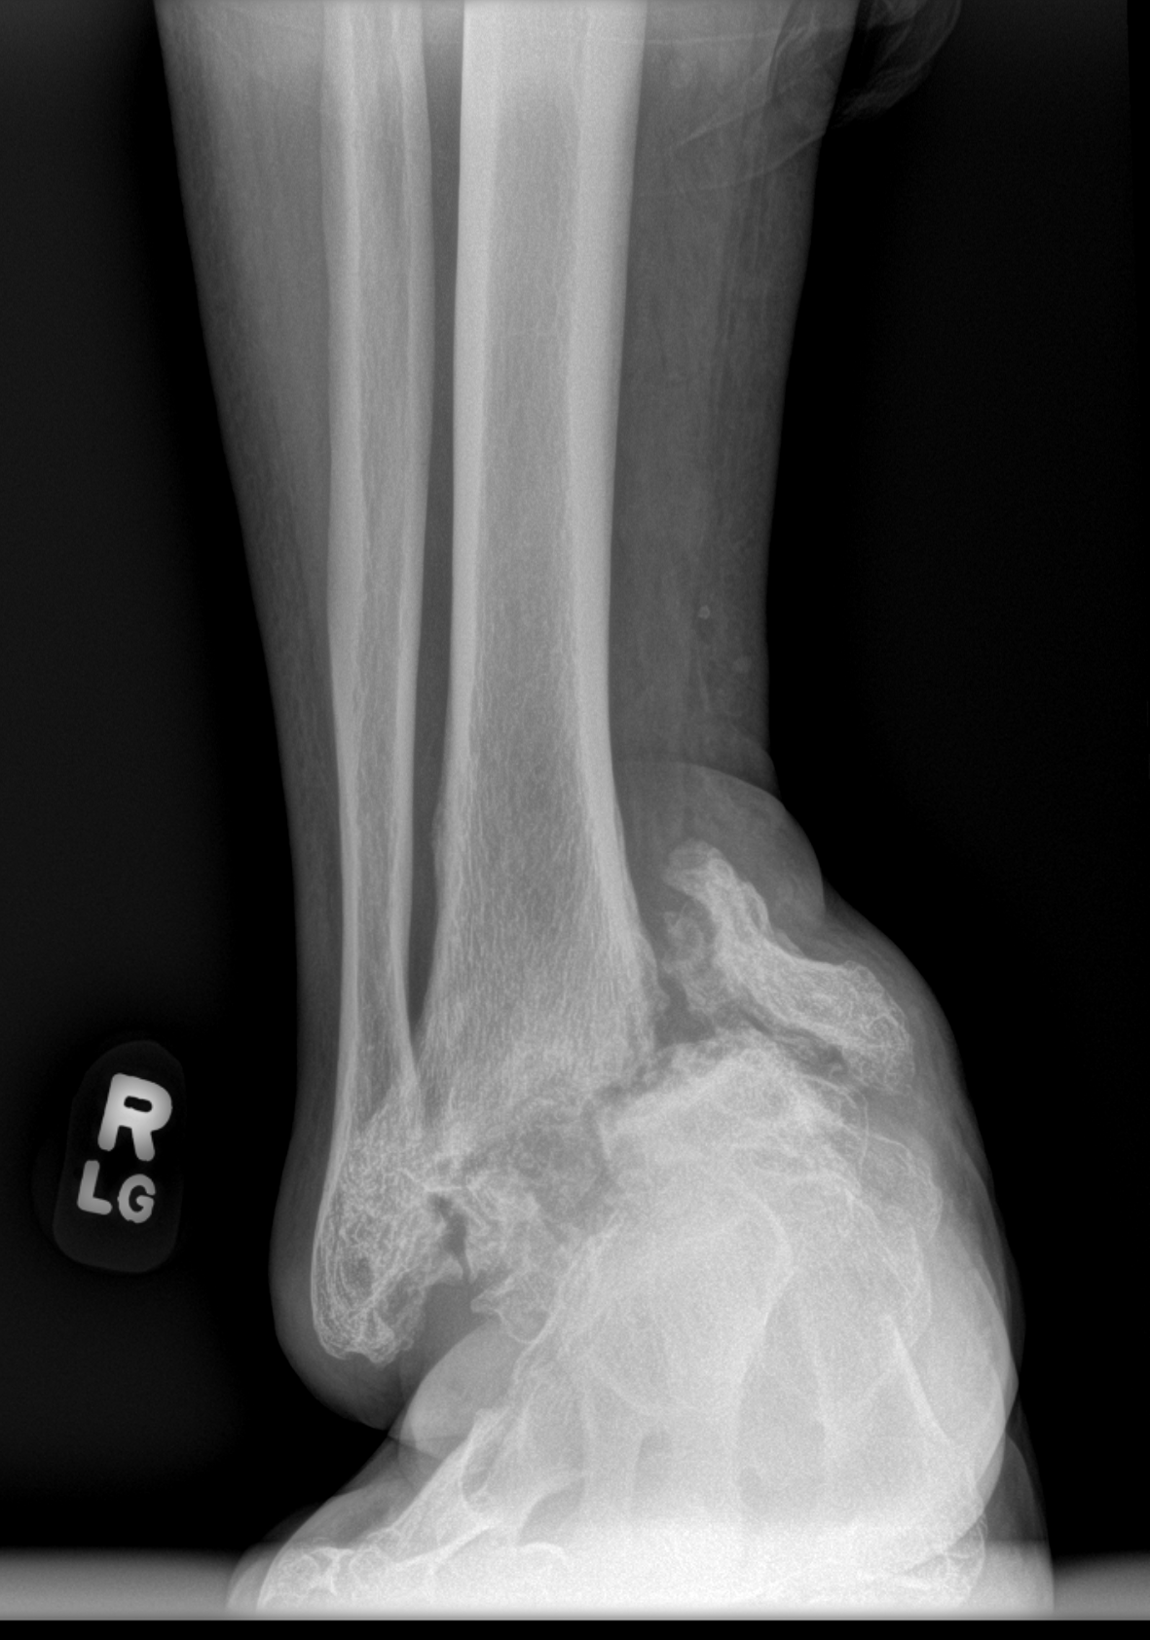
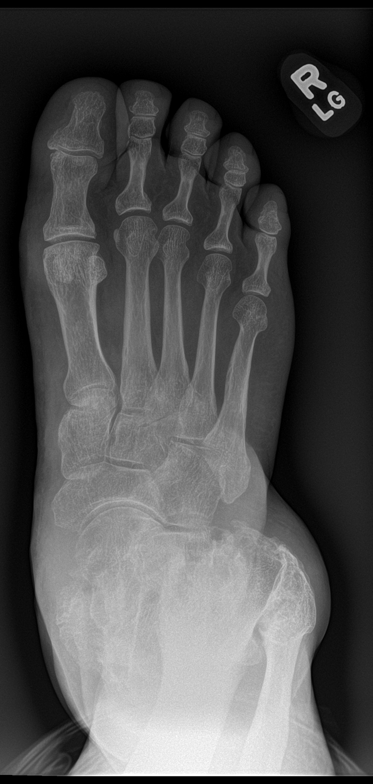
Xrays

Slide 7
Orders & Labs
Labs
HbA1C : 5.8
CBC normal
BMP: elevated BUN and Creatinine, all else normal
Xrays: Lumbar spine, chest xray, left knee
Left knee osteoarthritis
Degenerative disc disease L2-L3 with multilevel facet joint hypertrophy
Referrals
Primary care
Cardiology: Patient to schedule follow up and obtain clearance
Nephrology: Evaluation of kidney function
MRI and CT scan ordered

Slide 8
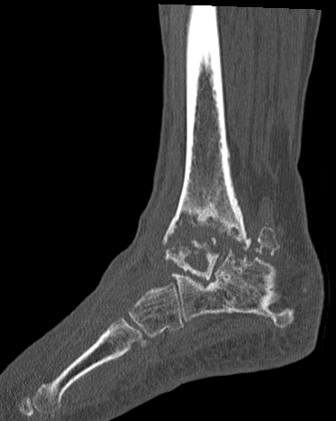
CT

Slide 9
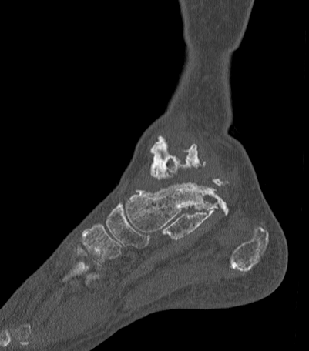
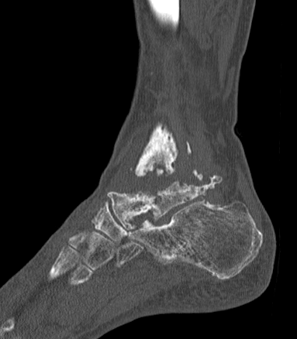

Slide 10
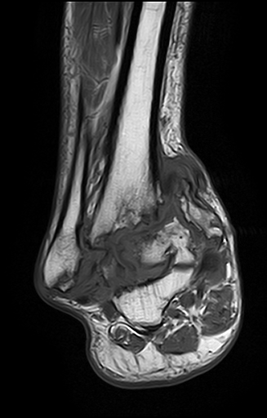
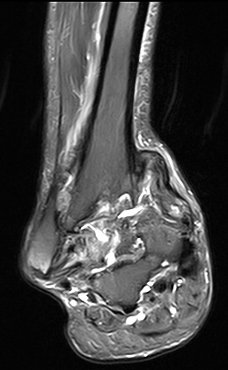
MRI

Slide 11
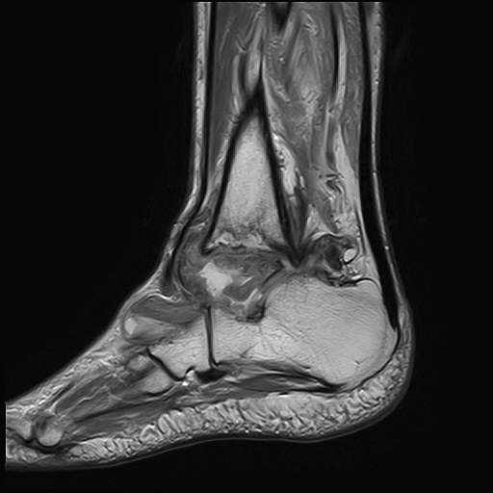
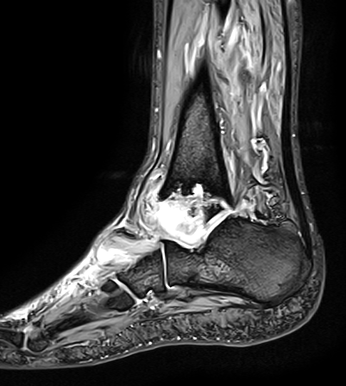

Slide 12
Differential Diagnosis
Charcot Neuroarthropathy
Septic joint + osteomyelitis
Chronic ankle instability with AVN and osteoarthritis

Slide 13
Bone Biopsies
Patient cleared by cardiology and primary.
Bone biopsies + cultures obtained from
Tibia
Fibula
Talus
Navicular
Calcaneus
+ Tibiotalar joint aspiration
All negative

Slide 14
Treatment options
Conservative - CROW boot
Surgical-
Talectomy with tibial-calcaneal fusion with IM rod vs ex fix
Tibial Calcaneal fusion with femoral head allograft
Custom talus + ankle joint replacement
Custom talar cage with IM rod fusion
TN fusion vs articulating talar head
BKA

Slide 15
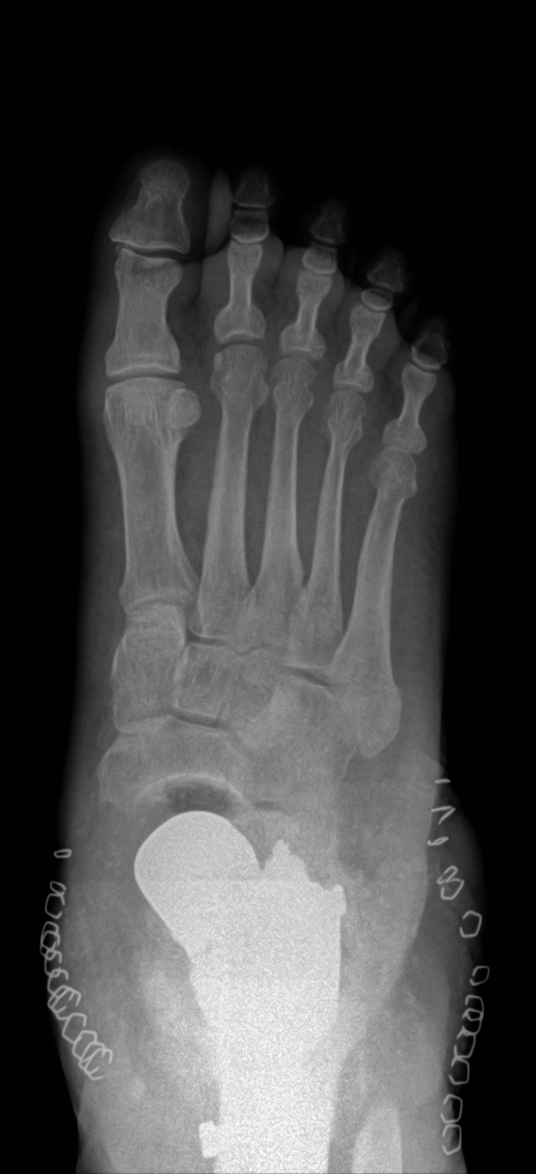
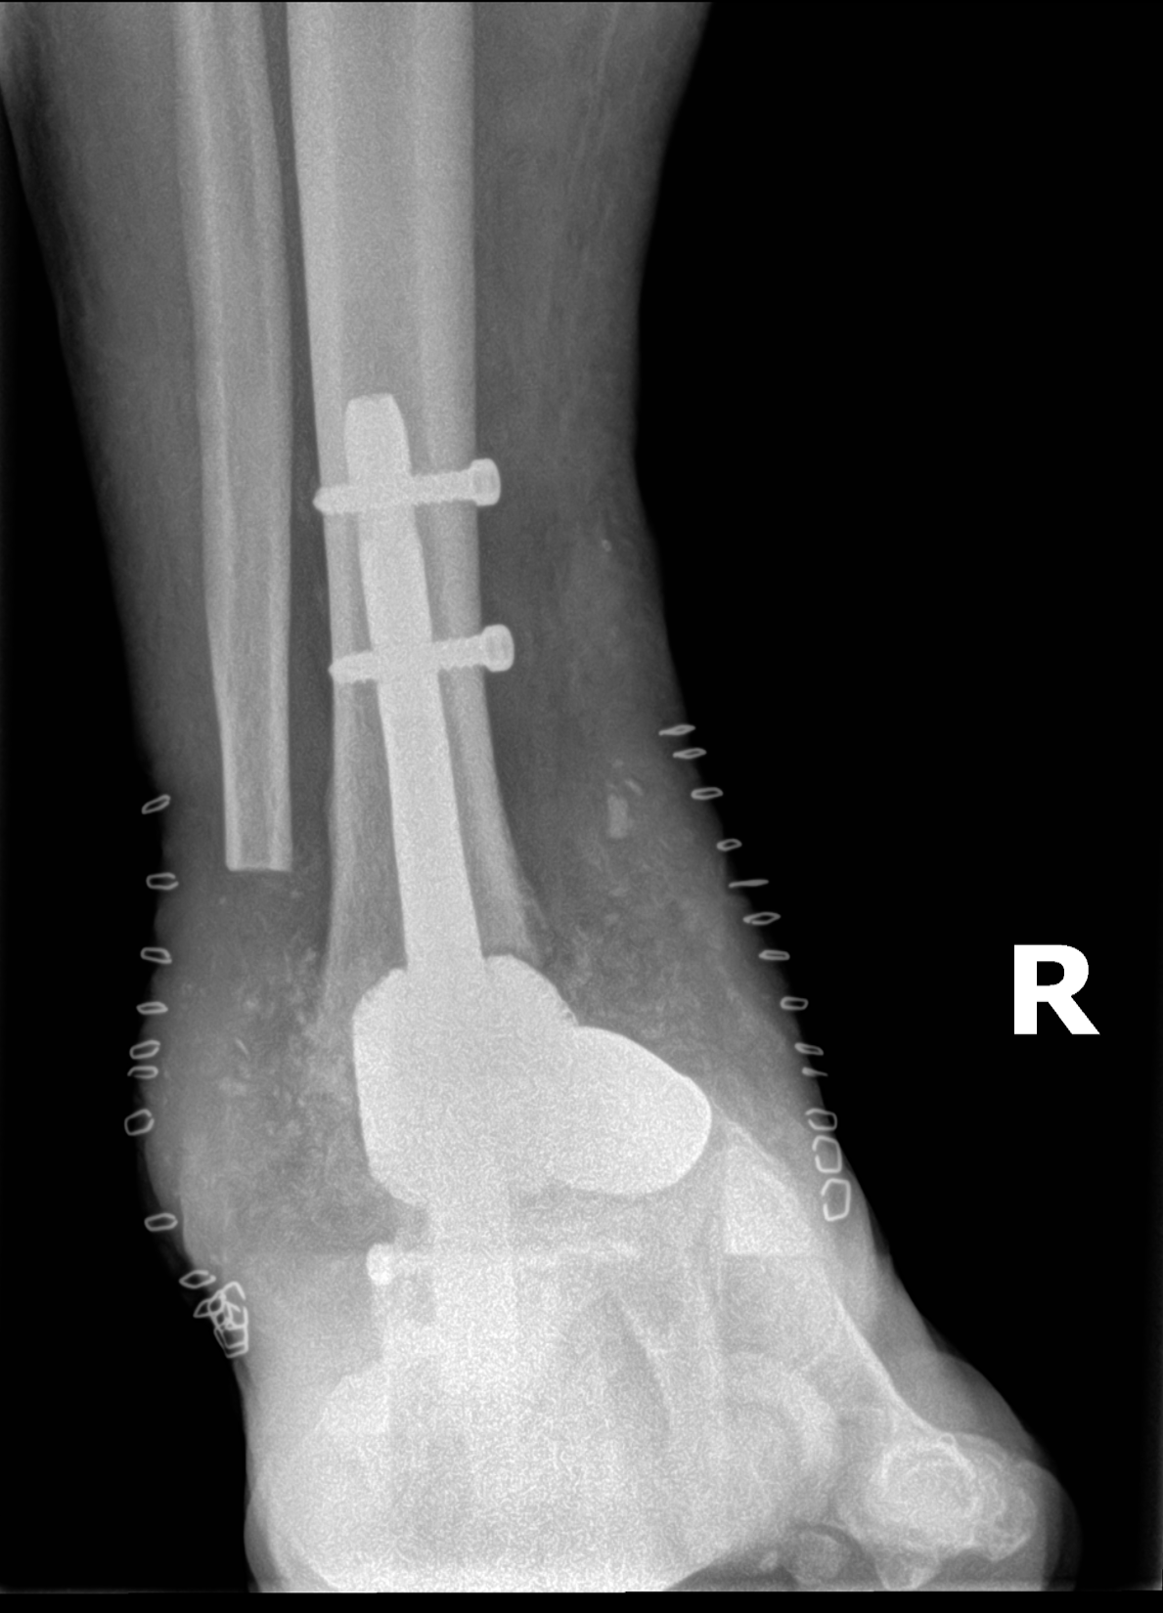
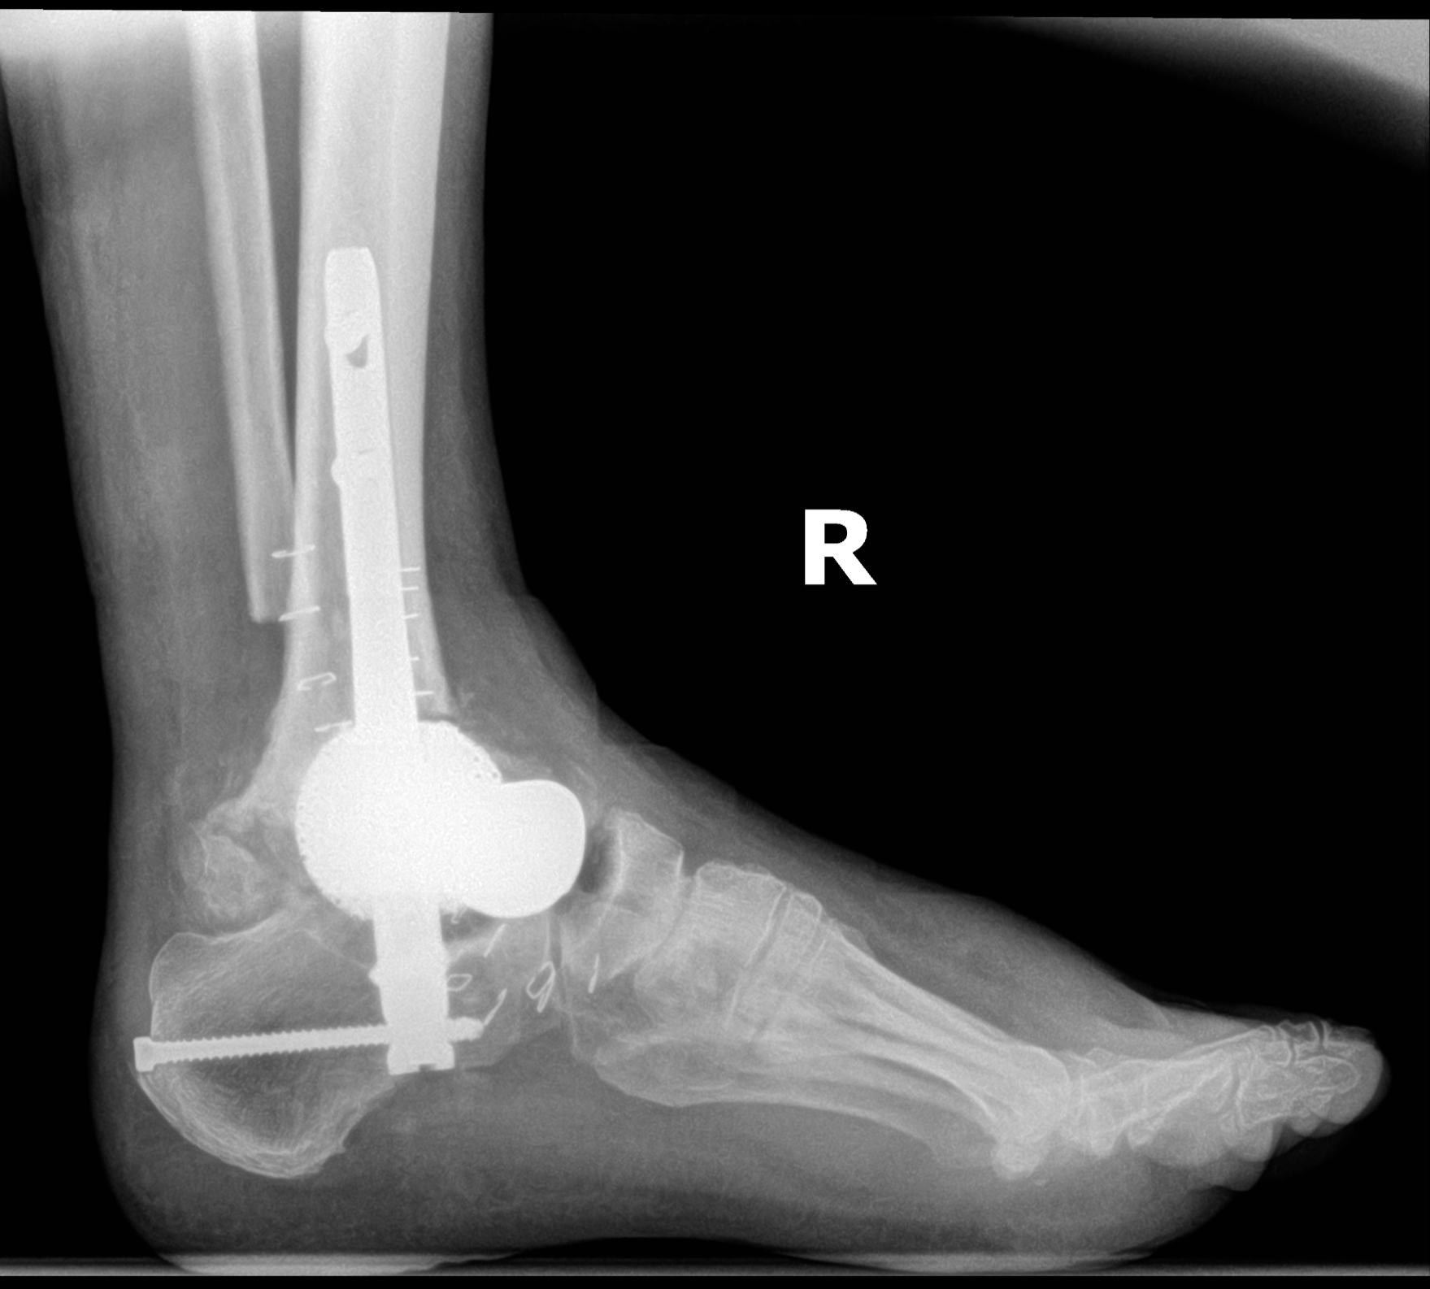
1 week post op

